Slide 2
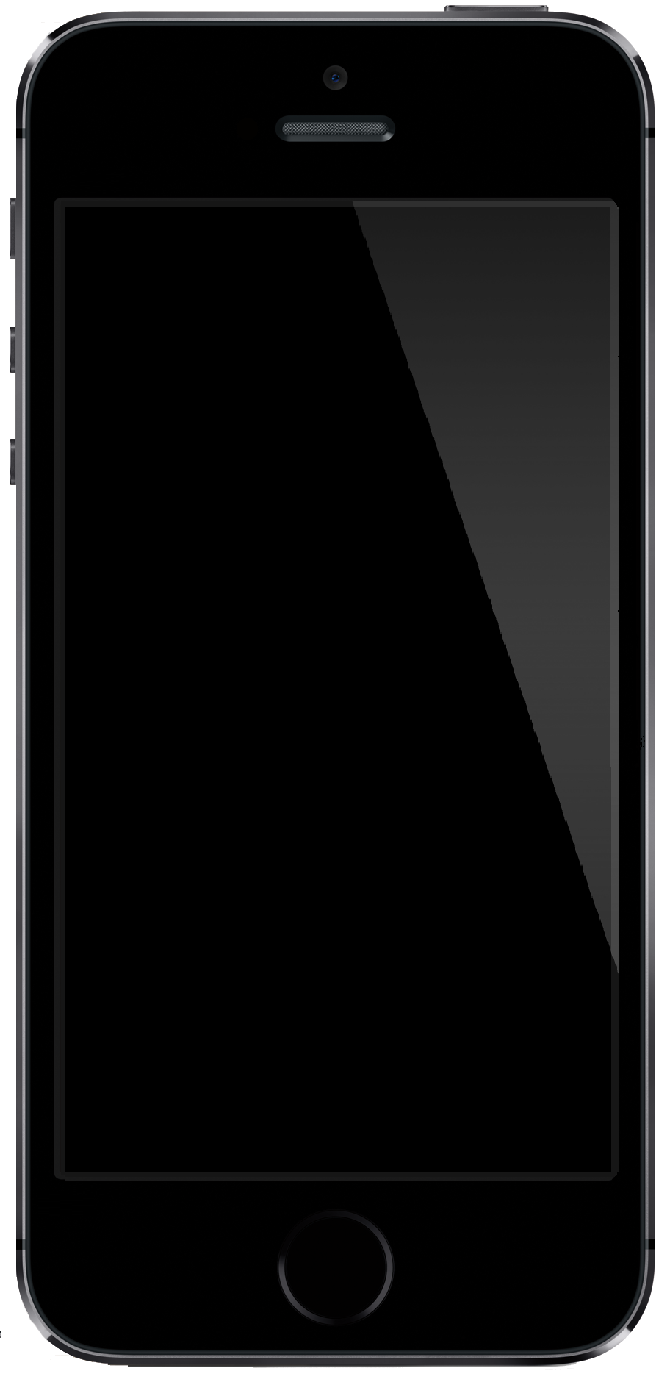
The Multi-Screen
Media Ecosystem
Pierre C. Bélanger, Ph.D
Department of Communication
University of Ottawa
The Multi-Screen
Media Ecosystem
The Multi-Screen
Media Ecosystem
Pierre C. Bélanger, Ph.D
Department of Communication
University of Ottawa
The Multi-Screen
Media Ecosystem
Pierre C. Bélanger, Ph.D
Department of
Communication
University of Ottawa
Pierre C. Bélanger, Ph.D
Department of Communication
University of Ottawa
Notes:
Cliché de dire de nos jours que ns vivons une révolution techno…
Ca fait près de 600 ans que ns vivons une révol techno…si l’on accepte de prendre pour pt de départ la presse rotative de Johanne Gutenberg…ou plus de 1k ans si vs etes de ceux qui croient que les moines cisterciens ns ont rendus le plus grand service en mettant à pt l’horloge canoniale pour réguler leur temps de prière au courant de la journée
que le numérique chamboule tout sur son passage.
Cliché sûrement maid aussi tres juste
La télé vit une mutation industrielle accélérée alimentée
Y a pas si longtemps, un des sujets de conversation les plus communs à l’arrivée au travail était:
“As-tu regardé hier soir à la télé..l’Émission X?”
C’était l’époque des médias de masse,des grands RDV télé, du broadcasting…comme on dit en chinois!
Ajd…c devenu un peu plus compliqué de parler de la télé car il n’y a plus que le téléviseur qui ns présentent des émissions
-accès à des canaux en ligne tels que YouTube diffusant du contenu de courte et de longue durée
-à des services de VOD par contournement tels que Netflix Cda ou Hulu pour ceux qui peuvent obtenir une adresse IP aux États-Unis,
-à des signaux de télé piratés, diffusés en mode continu ou téléchargés par Internet.
ces types de contenu peuvent être visualisés non seulement à la télé, mais aussi sur des ordis personnels, des tablettes et des téléphones intelligents.

Slide 3
Disruption technologies
According to Forrester Research,
100% of industries
will be in in a digital disruptive situation
over the next 5 years
Global Perspectives on What’s Next, organisé par la SoDA, the Digital Society, Barcelone, 2014
Notes:
http://www.infopresse.com/opinion/pascal-hebert/2014/8/11/industrie-numerique-et-modeles-d-affaires-trois-constats
Déjà, cette année, plus de 50% des industries sont en disruption.
Pensons simplement aux transformations des industries de la musique, de la télé, du voyage, des banques et du commerce de détail.
ACHATS PROGRAMMATIQUES AOL ONE en pub: À titre eg., les services d’achats médias et de développement web risquent fortement d’être transformés par l’automatisation et le développement web assisté.
Réduction des marges bénéficiaires
D’ailleurs, notre propre industrie de services professionnels sera aussi chamboulée. Le modèle d’agence, par eg, est un modèle d’affaires qui n’a pas évolué ces dernières années et qui sera, lui aussi, changé par le numérique. D’une part, plusieurs services deviendront des commodités sans valeur ajoutée pour les clients et les employés.
D’autre part, les marges bénéficiaires rétrécissent continuellement, peinant à apporter de la valeur aux actionnaires. En moyenne, dans le monde, les marges ont fondu de quatre points de pourcentage ces deux dernières années. C’est important. Cela dit, ce n’est pas unique à notre industrie. La pression des marchés financiers sur les marges à un impact important sur les agents, tant ceux qui oeuvrent en distribution qu’en pub, en finance ou en voyage.

Slide 4
500 million connecting devices
Strategy Analytics,
Notes:
https://gigaom.com/2014/10/03/there-are-now-half-a-billion-streaming-devices-in-households-around-the-world/
Cord-cutting SCREEN STACKING
key priorities for our research are to identify emerging business models, effective partnerships, & engagement strategies that help develop profitable consumer products & services.”
There are now half a billion streaming devices in households around the world
OCT. 3, 2014 Game consoles are still leading the charge, but Chromecast grew faster than any other player this yr.
No wonder Netflix and others are streaming billions of hours every month: Consumers around the world now own half a billion streaming devices, according to a new report from Strategy Analytics. The most popular brand is still Sony, with a total instal base of 123.8 million devices, a number that’s largely driven by the company’s PS3 and PS4 game consoles.
The biggest growth is coming from non-gaming devices: LG saw 101.9 % growth yoy with its smart TVs and connected Blu-ray players, according to Strategy Analytics estimates, followed by Toshiba with 98.8 % year-over-year growth.
And on a quarterly basis, Google saw bigger increases from Q1 to Q2 of this year than any other vendor, thanks to Chromecast, with Strategy Analytics estimating a total of 6 million Chromecast devices sold by Q2 2014. We’ll ask Chromecast VP Mario Queiroz whether that number looks right to him when we have him on stage at Structure Connect later this month.

Slide 5
People don’t care about the plateform.
Only thing that matters is content.
Kevin Spacey
Conférence IAB MIXX
New York, September 2014
Notes:
01 OCT. 2014
Advertising Week: Kevin Spacey secoue l’industrie http://www.infopresse.com/article/2014/10/1/ad-week-kevin-spacey-secoue-l-industrie
«Le public se moque de la plateforme. Ce qui l’intéresse, c’est le contenu». Lors d'une conf à New York, Kevin Spacey est revenu sur l’importance de briser le moule, oser l’échec et produire du contenu authentique.
La tête d’affiche de House of Cards a clôturé la conférence IAB MIXX à NY avec une présentation devant les professionnels de l’industrie. Il s’est prononcé sur de nombreux sujets, à partir de son expertise multiplateforme et de sa présence dans la série qui a changé la donne en matière de consommation média. Diffusée sur Netflix et proposée en rafale, House of Cards a contribué à changer les méthodes traditionnelles de diffusion, selon Kevin Spacey: «Nous n’avions pas à nous soucier d’aucune des choses stupides du monde Nielsen» AUCUNE CASE HORAIRE
Ces nouveaux modes de diffusion permettent le maintien d’une authenticité créative, sans compromis, toujours selon l’acteur, qui rappelle que dans un monde de consommation préfabriqué, les gens sont «nourris de mélasse depuis si longtemps, qu’ils la détectent à un mille à la ronde».
Selon lui, il faut oser et prendre des risques, car avec des appareils comme Oculus Rift jusqu’à ceux que nous utilisons quotidiennement, «nous avons la techno, il suffit de s’activer et de l’utiliser».
L'événement Advertising Week propose plus de 250 activités et conférences à 90k participants et se déroule à New York jusqu'au 2 octobre.

Slide 7
Notes:
Perhaps the biggest surprise winner at the Oscars was the often-overlooked marketing stratagem of product placement.Samsung took the honors in the You Get What You Pay For category. Combine the sociability of Ellen DeGeneres with the social-networkability of Twitter and the purchase of more than 5 minutes of ad time that was going at about $1.8 million per :30 and, voila, you have a star-studded shot taken with a Samsung Galaxy that was retweeted more than 2 million times by the end of the telecast, “The earth was on the receiving end of the latter type … when social media-happy host Ellen DeGeneres pulled together celebs from the first few rows of the audience for what she called the "most retweeted selfie of all time.” And she called it that before she even took it. Shortly after she did, it became a selfie-fulfilling prophecy.
The fact that it was a blatantly obvious marketing gimmick did not make it any the less effective.
One other marketer, a fast food chain, hit it big with a product placement on the Oscars last night. About midway through the show, DeGeneres suggested that the time was right for some pizza. When the deliveryman arrived, he was not from the likes of Dominos or Papa John’s but rather from 20-store Los Angeles-based chain called Big Mama’s and Papa’s Pizzeria.
The franchise operation was quick to post a YouTube video of the apparently free plug to its home page — much quicker than it has been to post any content to its FAQ section or to update its 2012 copyright line — but it was just as quickly blocked by AMPAS Oscars on copyright grounds.
But you can catch a slice of the action on the ABC News site, where Michael Howard reports “the man in the red baseball cap and maroon hoodie passing out slices to the star-studded crowd is an employee for the shop — and not an actor.” An employee at the restaurant that’s located “not too far from” the Dolby Theater told ABC News “Ellen’s talk show has picked up quite a few pizzas from us.”
selfie was a great eg of cross-channel. Yes, it had lots of photogenic people in it. But it worked because it happened on live appointment TV with Ellen providing a call-to-action for viewers to go to a 2nd screen and make the stunt into a record breaker. Twitter got an indirect shout out when Meryl said at the periphery of Ellen's mike that she had never Tweeted before. And, for anyone who didn't immediately realize that that was a sponsoring Samsung phone in Ellen's hand, numerous secondary sources are connecting the dots as they virally spread the brand impression through unpaid day after commentary.
http://www.theatlantic.com/entertainment/archive/2014/03/internet-tv-was-the-big-loser-on-oscar-night/284173/
Ellen Makes Selfie-Fulfilling Prophecy For Samsung Mar 3, 2014, 7:53 AM
http://www.mediapost.com/publications/article/220610/ellen-makes-selfie-fulfilling-prophecy-for-samsung.html?edition=70412

Slide 8
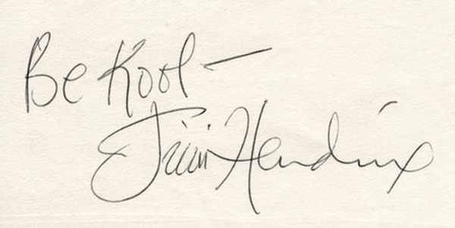
Selfies did away with…
“I haven't been asked for an autograph since the invention of the iPhone with a front-facing camera. The only memento "kids these days" want is a selfie. It's part of the new currency”
Taylor Swift, Wall Street Journal
Notes:
http://www.wsj.com/articles/for-taylor-swift-the-future-of-music-is-a-love-story-1404763219

Slide 10
Notes:
http://www.adweek.com/news/technology/65-facebooks-video-views-are-mobile-devices-162214
Sixty-five percent of global Facebook video views occur on mobile devices, according to the social media giant, which revealed a handful of stats today.
"Consumers use their mobile devices to view and share content anytime, anywhere," said David Deal, a digital marketing consultant in Chicago, after learning of the new data point. "Smart brands will use Facebook to share video content that engages consumers in the moment on their devices."
Here are the other numbers the Menlo Park, Calif.-based company released in a blog post:
In the last 12 months, the number of video posts per Facebook user has increased 75 percent globally and 94 percent in the United States.
Internationally, clips from consumers and marketers in the newsfeed have risen 3.6 times year over year.
On average, more than 50 percent of U.S. users who visit Facebook daily watch at least one video.
From a HawkPartners study commissioned by Facebook that surveyed 2,418 Facebook users in the U.S., 76 percent said Facebook is the place where they most often discover videos. Other choices included YouTube, "directly from a friend," Google, Twitter, Tumblr, Instagram, Pinterest and others.
While self-reported, the numbers lend themselves to a narrative that emerged at the end of 2014: Facebook has given Google's YouTube serious cause for concern after the latter dominated the online video space for years. Facebook is also evidently attempting to poach YouTube talent.
"Google is freaking out," a media agency executive recently told Adweek.
Mark D'Arcy, chief creative officer for Facebook's Creative Shop, said, "We are only just starting to unlock the potential of sight, sound and motion in a feed-driven world."

Slide 12
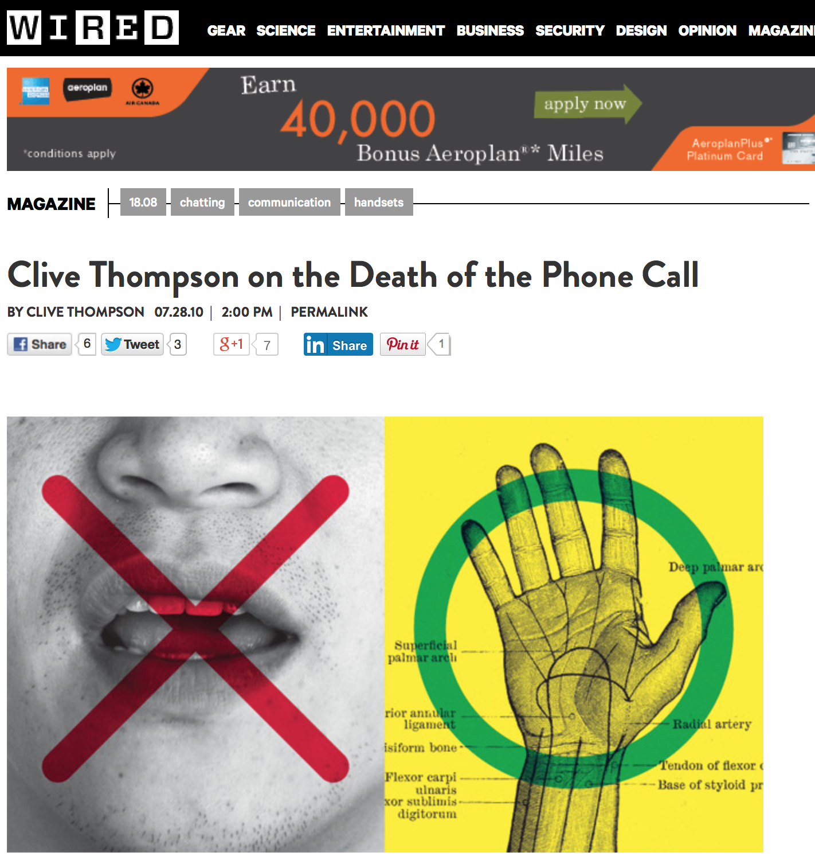

Slide 13
Notes:
BELGIAN CITY LAUNCHES ‘TEXT WALKING LANES’ FOR SMARTPHONE ADDICTS
June 15, 2015
http://www.digitaltrends.com/mobile/belgian-city-launches-text-walking-lanes-for-smartphone-addicts/?utm_source=Sailthru&utm_medium=email&utm_term=DT Newsletter&utm_campaign=DT Newsletter 2015-06-15
People’s apparent eagerness to stay connected at all times means we’re seeing more and more folk walking the streets lost in their phones. thing is, this growing distraction means many smartphone addicts are risking life and limb as they go about their day, with near misses and collisions occurring at an increasing rate.
In an effort to put phone users on the right track and ease the stress of the disgruntled pedestrians that have to dodge them, a city in Belgium has created several “text walking lanes.”
Following in the footsteps of Washington, DC, and Chongqing in China, the special lanes have been painted onto a number of Antwerp’s busiest shopping streets. While the measure is, in reality, a marketing stunt by local mobile firm Mlab, it’s likely that many in the area wouldn’t mind keeping the markings.
‘Everyone text-walks’
‘This causes collisions with poles or other pedestrians. You could, unknowingly, even be endangering your own life while you text-walk when you cross the street without looking up.”
Indeed, there have been all manner of stories in recent years of phone addicts walking off piers or into canals.
Related: As if we needed proof, video shows perils of using smartphone behind wheel
Research firm Pew said recently that according to U.S. ER data, pedestrian injuries due to handset distraction has risen by 35 % in the last 5 yrs.
Its report points out that in an effort to reduce the # of accidents linked to distracted walking, states such as Utah and New Jersey have experimented with fines for wandering texters who put themselves in hazardous situations. In addition, speed limits were reduced last year in parts of NY City for safety reasons. The move should mean that if a smartphone user does wander into the street without realizing, the driver may be able to take avoiding action instead of mowing them down.
Read more: http://www.digitaltrends.com/mobile/belgian-city-launches-text-walking-lanes-for-smartphone-addicts/#ixzz3nh4soQwO

Slide 14
Notes:
https://medium.com/@cshirky/last-call-c682f6471c70
Mark Ramsey 15 nov 2014
Radio broadcasters have made much fuss about Seth Godin’s post this past week titled “an end of radio.”
In it, Seth referenced the conversation he and I had eight years ago about the future of radio and how it would likely be impacted by access to unlimited online radio alternatives.
It’s hard to believe our conversation was that long ago – 2006 B.M.E (that’s Before the Mobile Era).
At the time, Seth theorized an end would come with city-wide wifi. He writes:
I realized last week that this has just happened. Not via wifi, but via Bluetooth and the smart phone. The car-sharing driver (Bluetooth equipped car, with a smart phone, of course) who picked me up the other day was listening to a local radio station. It was almost as if he was smoking a pipe or driving a buggy. With so many podcasts, free downloads and Spotify stations to listen to, why? With traffic, weather and talking maps in your pocket, why wait for the announcer to get around to telling you what you need to know?
Seth continues:
The first people to leave the radio audience will be the ones that the advertisers want most. And it will spiral down from there. Just as newspapers fell off a cliff, radio is about to follow. It’s going to happen faster than anyone expects.
Let’s step back from Seth’s somewhat overheated rhetoric (and I know my overheated rhetoric) for a second.
This week I was in a late model UBER SUV driving from Manhattan to JFK in morning drive-time. Of course, the driver had his Bluetooth and his smartphone. And he was listening to a remarkably conventional radio on the dashboard, its green LED dial positions softly glowing like a CASIO watch from the mid-70’s.
For more than 30 minutes I watched him navigate the radio dial at the most cluttered time in one of America’s most cluttered markets.
He punched the button probably a dozen times. From WKTU to AMP to The Beat to LITE and back again.
As I watched this customer experience I was struck by how potentially crappy it was. He punched out of one station’s traffic report (his navigation device featured traffic info) only to land on another. When you tune out for traffic the last thing you want to land on is more traffic.
The same thing happened with spots. Punch: Spots. Punch: Spots. He didn’t punch out at the first spot, but he seemed to reach a breaking point after two or three.
And quite often, the on-air conversation was tough to differentiate from spots. I could see the subtle workings of his mind in action: How close am I to a song? Is it worth “rolling the dice” on another station, or should I simply wait?
It’s not that this was frustrating for him. This was simply all he knows. It’s what radio has taught him to expect after generations of stations that have no other points of reference than each other.
We have cluttered ourselves in direct proportion to how our competitors clutter themselves. We have tried to satisfy all the demands of every listener every morning even though all other stations are trying to satisfy all the same demands, thus reducing the distinctions between stations. We have turned service elements into profit centers thus guaranteeing that they can never go away, even if their disappearance would make us better at the one thing listeners come to us for.
Stations only counter-program each other – they don’t counter-program radio alternatives, like Pandora, even though these are real and rising options to your local station. They are the very alternatives Seth is alluding to.
I asked the driver: “How come you don’t listen to Pandora?”
“Do I have to download that?” he asked.
“Yes,” I said.
“I don’t know how to do that,” he said.
“You download it on your mobile phone,” I replied.
“We’re not supposed to play with our phones while driving in New York,” he replied.
I could have explained that downloading an app on his iPhone was not only super-easy, but I’m quite sure he knows how to do it. I could have explained that an upgraded technology package in his car could help solve that problem. I could have explained that one day, Apple’s CarPlay and Android Auto will one day automatically update his vehicle to the latest technology. I could have explained that Pandora would function with minimal distractions in such a setup, or that he could even simply hook up his phone to his Bluetooth for music the way it was hooked up for calls.
But that would require having a consumer with a problem. This consumer had none, and thus he was not anxious to seek out a solution.
And that’s why the driver in Seth’s car was listening to the radio in the presence of all that technology, whereas Seth and I and perhaps you might have long since bolted to the musical stylings of Pandora or the bountiful world of podcasts.
So when Seth says “just as newspapers fell off a cliff, radio is about to follow. It’s going to happen faster than anyone expects,” he is not talking about this particular consumer – and this guy, don’t forget, spends his entire workday in his car. To be sure, there are more people like him than unlike him.
I asked a local auto dealer how many inquiries from would-be buyers they were getting for Apple CarPlay or Android Auto. One of their lead sellers put it simply: “None.”
Is there a cliff for radio? More like a gentle slope, but one that slopes downward. Make no mistake about that.
When Seth argues, “the first people to leave the radio audience will be the ones that the advertisers want most. And it will spiral down from there,” the truth is that it will be less a spiral than a slow leak, but leak it shall, nonetheless.
And it has already begun with the most urban and affluent and tech-savvy and young among us. Indeed, if you find yourself in a circle of these folks good luck finding a fan of music-oriented radio stations. That’s why an Apple employee once memorably told me “Steve Jobs doesn’t think anybody listens to the radio.”
Steve was notoriously binary, of course. The truth is that average folks – like my driver and Seth’s – are many – that’s what makes them average. And while advertisers value the affluent and young, they place more value on the many over the few.
The real question is this: When will the radio industry realize its competition for the attention of consumers is not simply the other stations in the Nielsen ranker, it’s also all the other ways I can entertain myself while in my car, thanks to the rapid march of mobile technology.
Viewing your universe the way the Nielsen ranker does may help you secure the buy, but it will also speed your long-term demise.
Even if Seth’s timeline is wrong, his essential conclusion is not. Things will change. Today’s drivers will be replaced by their digital native offspring.
If you don’t get ready now, later will be too late.

Slide 15
Notes:
http://www.mediaweek.co.uk/article/1349740/end-magazine-business-know?DCMP=EMC-CONMediaPMBulletin&bulletin=mediapm&utm_medium=EMAIL&utm_campaign=eNews%20Bulletin&utm_source=20150604&utm_content=www_mediaweek_co_uk_artic_15
The end of the magazine business as we know it
by Arif Durrani, added 37 hours ago
Magazine publishers finally feel optimistic and see growth on the horizon, as the PPA Festival showed. By Arif Durrani.
Tweet
3
This page has been shared 3 times. View these Tweets.
Like 13
1
in
Share
17
PPA Festival: chief executives of publishers discussed challenges and successes at the event
What to make of May's PPA Festival, held in Holborn, London, just down the road from the salubrious Lincoln's Inn Fields address where the magazine body used to be based; back in the days when the industry was awash with money.
Let’s be in no doubt that, up until the last decade, magazines were a very profitable business indeed. Identifying the right gap in the market was the hard bit. But, once established, making money from selling regular printed copies and ad pages made some owners very wealthy indeed.
For the late Felix Dennis, it was Bruce Lee and personal computers that catapulted him to fame and riches. For Tony Elliott, it was London’s arts and culture. For Haymarket's own Michael Heseltine it was niche lifestyle, and then motoring, management and marketing titles.
So, as the delegates watched David Hepworth – of Smash Hits fame – interviewing GQ’s stalwart editor, Dylan Jones, it was hard not to feel a tad nostalgic. The men's magazine has morphed from yuppie bible to high-end lads’ mag and back again over the years.
Jones reminded us that it had been Heseltine, the thrusting political Tarzan and founder of Haymarket, Campaign’s parent, who had adorned the first front cover of the British version of Gentlemen’s Quarterly back in 1988. Despite the explosion of media channels since then, the magazine’s circulation has fallen by just 7 to 8,000 copies in the 15 years Jones has been at the helm – quite a feat, and something he admitted to feeling "really proud about".
Elsewhere, there are still pockets of growth. It was somewhat reassuring to know Nicholas Coleridge, the president of Condé Nast International, remained "full of beans". He noted that Vogue, in its 98th year, had just experienced its most profitable 12 months.
Bauer Media’s Paul Keenan reminded the audience that Grazia, now in its 10th year, had managed to change the law with its Mind the Pay Gap campaign, before sneaking in a mention of the group’s radio success – it now boasts the top two commercial radio stations in London in Magic and Kiss.
Yet it would be wrong to deny the seismic changes taking place. In the digital age, the business is clearly not what it once was. Print circulations of the biggest magazines have been falling since 2008. The top 100 titles lost a further 15 million copies in the last six-month audit alone.
Underlining the point, Colin Morrison, the author of Flashes & Flames, notes the decline of one of the biggest sectors of the last 15 years: "The six best-selling celebrity weeklies, which fuelled media company profits in the years before they were upstaged by Twitter and YouTube, together now make the same profit once generated by Bauer’s Heat magazine alone."
But an undeniable sense of optimism pervaded the event nonetheless. After years of denial and anger, publishers appear to have turned a corner and accepted that the game has changed, and they are now busy changing their horizons.
Coleridge, of course, led the charge. "I’m very confident and in a rather expansionist mode at the moment," he said, flashing his trademark grin. "We are still launching magazines around the world but we’ve also just hired 100 people to work in Camden on a new e-commerce business that we’ve started."
'We’re now looking at completely new business models'
To use a term favoured by investors, publishers are now "pivoting" their businesses: think events, e-commerce, e-learning, video and digital. The print cash cows will continue to be nurtured but the focus is on their engagement and relationships with readers, not the medium itself.
Anna Jones, chief executive of Hearst, stressed the changes taking place by noting that while others still talk excitedly about being "digital-first" and now "mobile-first", at the home of Cosmopolitan, Good Housekeeping and Red, the focus is on being "platform-specific" – with editorial providing the best content for readers, tailored to the surroundings in which it reaches them.
During a time of such transition, developing and retaining the best talent has become top of mind for publishers. Immediate Media's chief executive Tom Bureau spoke eloquently and passionately about the importance of nurturing culture and to instil in employees an "emotional attachment" with the business.
As the publisher of magazine brands including Radio Times, Good Food and Olive as well as specialist titles Bike Radar and Simply Knitting, Bureau said success today is "all about how you get the right people motivated and moving at pace". He talked about the need to break down silos and hierarchies to attract younger talent, and added: "In a people business, how you treat them makes a difference."
And it is not only the millennials who were benefitting from this new world order in magazines. GQ's Jones, PPA's editor of the year no less, admitted the evolution of the marketplace had kept him interested during his 15 year tenure.
"If the magazine world was the same as it was five years I don't think I'd still be in it," he admitted. "Because there's a lot of repetition... but it has completely changed."
For Marcus Rich, Time Inc UK’s chief executive, who bravely admitted his wife said he’s "average at everything" apart from prog rock stats, the event's recurring theme of change must have represented a vindication of sorts.
The former newspaper man had received considerable kick back from peers at his first PPA event last year when he had suggested the industry needs to move on from the "burning platform [of magazines] into a growth business".
His emotive soundbite had ensured the headlines, but his wider message of a business needing to recalibrate had been lost in the process. This year, the leader behind the likes of InStyle, Livingetc, Woman's Weekly and Marie Claire, nailed the new sense of purpose.
"We’re now looking at completely new business models," Rich said. "I think publishers have a greater appetite for risk. I think they are more prepared to fail as they look to generate new revenue streams."

Slide 16
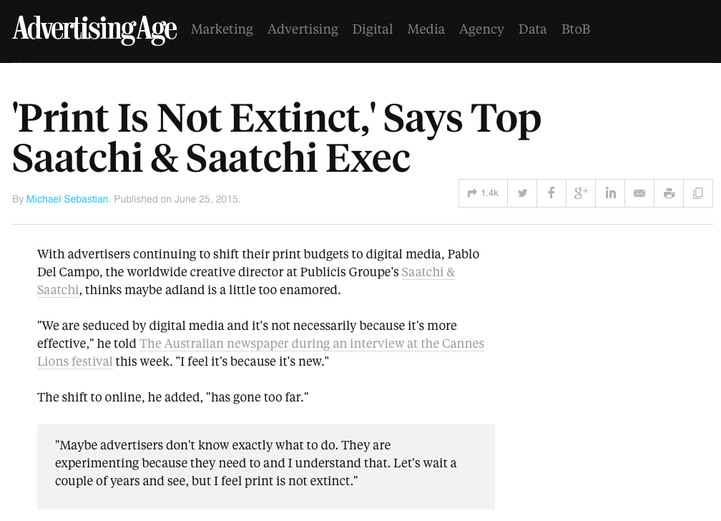
Notes:
http://adage.com/article/media/print-extinct-top-saatchi-saatchi-exec/299233/?utm_source=mediaworks&utm_medium=newsletter&utm_campaign=adage&ttl=1435864879
'Print Is Not Extinct,' Says Top Saatchi & Saatchi Exec
By Michael Sebastian. Published on June 25, 2015.
With advertisers continuing to shift their print budgets to digital media, Pablo Del Campo, the worldwide creative director at Publicis Groupe's Saatchi & Saatchi, thinks maybe adland is a little too enamored.
"We are seduced by digital media and it's not necessarily ­because it's more effective," he told The Australian newspaper during an interview at the Cannes Lions festival this week. "I feel it's because it's new."
The shift to online, he added, "has gone too far."
"Maybe advertisers don't know exactly what to do. They are experimenting because they need to and I understand that. Let's wait a couple of years and see, but I feel print is not ­extinct."
Print is not extinct, but it's certainly losing interesting among advertisers. Last year, ad spending on consumer and business-to-business magazines in the U.S. fell 5.1% compared with 2013, according to research from analytics firm Kantar Media Newspaper ad spending dropped 10% year over year, Kantar said. Still, Mr. Del Campo, who was named Saatchi & Saatchi's worldwide creative director in March 2014, said "print is still powerful."
His comments about print follow similar remarks from WPP CEO Martin Sorrell who stuck up for magazines and newspapers. "There is an argument at the moment going on about the effectiveness of newspapers and magazines, even in their traditional form, and maybe they are more effective than people give them credit [for]," Mr. Sorrell told an audience in March at a Broadcasting Press Guild breakfast in the U.K.

Slide 17
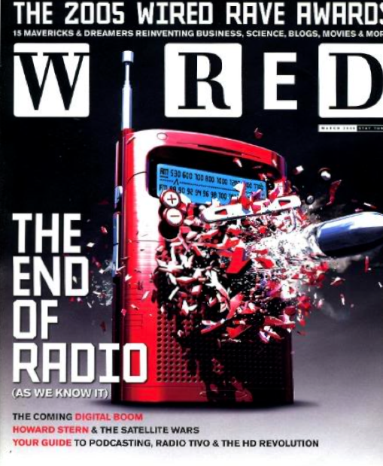
Notes:
Cover page mag de Wired en 2005 qui signalait l’importante transmutation que s’apprêtait à vivre la radio, il y a dejà 9 ans.
Operative words = "AS WE KNOW IT"
About the Mag: Issue 13.03 | March 2005
Pix source: http://mediamall.com/blogger/2005/02/wired-end-of-radio-really.html

Slide 18
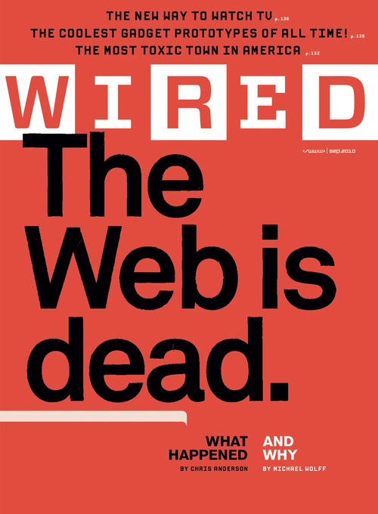
Notes:
Pix source: http://gawker.com/5615069/wired-says-the-web-is-dead---on-its-increasingly-profitable-website
The Web Is Dead. Long Live the Internet
By Chris Anderson and Michael Wolff August 17, 2010
http://www.wired.com/magazine/2010/08/ff_webrip/all/1
Two decades after its birth, the World Wide Web is in decline, as simpler, sleeker services — think apps — are less about the searching and more about the getting. Chris Anderson explains how this new paradigm reflects the inevitable course of capitalism. And Michael Wolff explains why the new breed of media titan is forsaking the Web for more promising (and profitable) pastures.
You wake up and check your email on your bedside iPad — that’s one app. During breakfast you browse Facebook, Twitter, and The New York Times — three more apps. On the way to the office, you listen to a podcast on your smartphone. Another app. At work, you scroll through RSS feeds in a reader and have Skype and IM conversations. More apps. At the end of the day, you come home, make dinner while listening to Pandora, play some games on Xbox Live, and watch a movie on Netflix’s streaming service.
You’ve spent the day on the Internet — but not on the Web. And you are not alone.
This is not a trivial distinction. Over the past few years, one of the most important shifts in the digital world has been the move from the wide-open Web to semiclosed platforms that use the Internet for transport but not the browser for display. It’s driven primarily by the rise of the iPhone model of mobile computing, and it’s a world Google can’t crawl, one where HTML doesn’t rule. And it’s the world that consumers are increasingly choosing, not because they’re rejecting the idea of the Web but because these dedicated platforms often just work better or fit better into their lives (the screen comes to them, they don’t have to go to the screen). The fact that it’s easier for companies to make money on these platforms only cements the trend. Producers and consumers agree: The Web is not the culmination of the digital revolution.
A decade ago, the ascent of the Web browser as the center of the computing world appeared inevitable. It seemed just a matter of time before the Web replaced PC application software and reduced operating systems to a “poorly debugged set of device drivers,” as Netscape cofounder Marc Andreessen famously said. First Java, then Flash, then Ajax, then HTML5 — increasingly interactive online code — promised to put all apps in the cloud and replace the desktop with the webtop. Open, free, and out of control.
But there has always been an alternative path, one that saw the Web as a worthy tool but not the whole toolkit. In 1997, Wired published a now-infamous “Push!” cover story, which suggested that it was time to “kiss your browser goodbye.” The argument then was that “push” technologies such as PointCast and Microsoft’s Active Desktop would create a “radical future of media beyond the Web.”
“Sure, we’ll always have Web pages. We still have postcards and telegrams, don’t we? But the center of interactive media — increasingly, the center of gravity of all media — is moving to a post-HTML environment,” we promised nearly a decade and half ago. The examples of the time were a bit silly — a “3-D furry-muckers VR space” and “headlines sent to a pager” — but the point was altogether prescient: a glimpse of the machine-to-machine future that would be less about browsing and more about getting.
As it happened, PointCast, a glorified screensaver that could inadvertently bring your corporate network to its knees, quickly imploded, taking push with it. But just as Web 2.0 is simply Web 1.0 that works, the idea has come around again. Those push concepts have now reappeared as APIs, apps, and the smartphone. And this time we have Apple and the iPhone/iPad juggernaut leading the way, with tens of millions of consumers already voting with their wallets for an app-led experience. This post-Web future now looks a lot more convincing. Indeed, it’s already here.
The Web is, after all, just one of many applications that exist on the Internet, which uses the IP and TCP protocols to move packets around. This architecture — not the specific applications built on top of it — is the revolution. Today the content you see in your browser — largely HTML data delivered via the http protocol on port 80 — accounts for less than a quarter of the traffic on the Internet … and it’s shrinking. The applications that account for more of the Internet’s traffic include peer-to-peer file transfers, email, company VPNs, the machine-to-machine communications of APIs, Skype calls, World of Warcraft and other online games, Xbox Live, iTunes, voice-over-IP phones, iChat, and Netflix movie streaming. Many of the newer Net applications are closed, often proprietary, networks.
And the shift is only accelerating. Within five years, Morgan Stanley projects, the number of users accessing the Net from mobile devices will surpass the number who access it from PCs. Because the screens are smaller, such mobile traffic tends to be driven by specialty software, mostly apps, designed for a single purpose. For the sake of the optimized experience on mobile devices, users forgo the general-purpose browser. They use the Net, but not the Web. Fast beats flexible.
This was all inevitable. It is the cycle of capitalism. The story of industrial revolutions, after all, is a story of battles over control. A technology is invented, it spreads, a thousand flowers bloom, and then someone finds a way to own it, locking out others. It happens every time.
Take railroads. Uniform and open gauge standards helped the industry boom and created an explosion of competitors — in 1920, there were 186 major railroads in the US. But eventually the strongest of them rolled up the others, and today there are just seven — a regulated oligopoly. Or telephones. The invention of the switchboard was another open standard that allowed networks to interconnect. After telephone patents held by AT&T’s parent company expired in 1894, more than 6,000 independent phone companies sprouted up. But by 1939, AT&T controlled nearly all of the US’s long-distance lines and some four-fifths of its telephones. Or electricity. In the early 1900s, after the standardization to alternating current distribution, hundreds of small electric utilities were consolidated into huge holding companies. By the late 1920s, the 16 largest of those commanded more than 75 percent of the electricity generated in the US.
Indeed, there has hardly ever been a fortune created without a monopoly of some sort, or at least an oligopoly. This is the natural path of industrialization: invention, propagation, adoption, control.
Now it’s the Web’s turn to face the pressure for profits and the walled gardens that bring them. Openness is a wonderful thing in the nonmonetary economy of peer production. But eventually our tolerance for the delirious chaos of infinite competition finds its limits. Much as we love freedom and choice, we also love things that just work, reliably and seamlessly. And if we have to pay for what we love, well, that increasingly seems OK. Have you looked at your cell phone or cable bill lately?
As Jonathan L. Zittrain puts it in The Future of the Internet — And How to Stop It, “It is a mistake to think of the Web browser as the apex of the PC’s evolution.” Today the Internet hosts countless closed gardens; in a sense, the Web is an exception, not the rule.
Monopolies are actually even more likely in highly networked markets like the online world. The dark side of network effects is that rich nodes get richer. Metcalfe’s law, which states that the value of a network increases in proportion to the square of connections, creates winner-take-all markets, where the gap between the number one and number two players is typically large and growing.
So what took so long? Why wasn’t the Web colonized by monopolists a decade ago? Because it was in its adolescence then, still innovating quickly with a fresh and growing population of users always looking for something new. Network-driven domination was short-lived. Friendster got huge while social networking was in its infancy, and fickle consumers were still keen to experiment with the next new thing. They found another shiny service and moved on, just as they had abandoned SixDegrees.com before it. In the expanding universe of the early Web, AOL’s walled garden couldn’t compete with what was outside the walls, and so the walls fell.
But the Web is now 18 years old. It has reached adulthood. An entire generation has grown up in front of a browser. The exploration of a new world has turned into business as usual. We get the Web. It’s part of our life. And we just want to use the services that make our life better. Our appetite for discovery slows as our familiarity with the status quo grows.
Blame human nature. As much as we intellectually appreciate openness, at the end of the day we favor the easiest path. We’ll pay for convenience and reliability, which is why iTunes can sell songs for 99 cents despite the fact that they are out there, somewhere, in some form, for free. When you are young, you have more time than money, and LimeWire is worth the hassle. As you get older, you have more money than time. The iTunes toll is a small price to pay for the simplicity of just getting what you want. The more Facebook becomes part of your life, the more locked in you become. Artificial scarcity is the natural goal of the profit-seeking.
What’s more, there was the additionally sobering and confounding fact that an online consumer continued to be worth significantly less than an offline one. For a while, this was seen as inevitable right-sizing: Because everything online could be tracked, advertisers no longer had to pay to reach readers who never saw their ads. You paid for what you got.
Unfortunately, what you got wasn’t much. Consumers weren’t motivated by display ads, as evidenced by the share of the online audience that bothered to click on them. (According to a 2009 comScore study, only 16 percent of users ever click on an ad, and 8 percent of users accounted for 85 percent of all clicks.) The Web might generate some clicks here and there, but you had to aggregate millions and millions of them to make any money (which is what Google, and basically nobody else, was able to do). And the Web almost perversely discouraged the kind of systematized, coordinated, focused attention upon which brands are built — the prime, or at least most lucrative, function of media.
What’s more, this medium rendered powerless the marketers and agencies that might have been able to turn this chaotic mess into an effective selling tool — the same marketers and professional salespeople who created the formats (the variety shows, the 30- second spots, the soap operas) that worked so well in television and radio. Advertising powerhouse WPP, for instance, with its colossal network of marketing firms — the same firms that had shaped traditional media by matching content with ads that moved the nation — may still represent a large share of Google’s revenue, but it pales next to the greater population of individual sellers that use Google’s AdWords and AdSense programs.
There is an analogy to the current Web in the first era of the Internet. In the 1990s, as it became clear that digital networks were the future, there were two warring camps. One was the traditional telcos, on whose wires these feral bits of the young Internet were being sent. The telcos argued that the messy protocols of TCP/IP — all this unpredictable routing and those lost packets requiring resending — were a cry for help. What consumers wanted were “intelligent” networks that could (for a price) find the right path and provision the right bandwidth so that transmissions would flow uninterrupted. Only the owners of the networks could put the intelligence in place at the right spots, and thus the Internet would become a value-added service provided by the AT&Ts of the world, much like ISDN before it. The rallying cry was “quality of service” (QoS). Only telcos could offer it, and as soon as consumers demanded it, the telcos would win.
The opposing camp argued for “dumb” networks. Rather than cede control to the telcos to manage the path that bits took, argued its proponents, just treat the networks as dumb pipes and let TCP/IP figure out the routing. So what if you have to resend a few times, or the latency is all over the place. Just keep building more capacity — “overprovision bandwidth” — and it will be Good Enough.
On the underlying Internet itself, Good Enough has won. We stare at the spinning buffering disks on our YouTube videos rather than accept the Faustian bargain of some Comcast/Google QoS bandwidth deal that we would invariably end up paying more for. Aside from some corporate networks, dumb pipes are what the world wants from telcos. The innovation advantages of an open marketplace outweigh the limited performance advantages of a closed system.
But the Web is a different matter. The marketplace has spoken: When it comes to the applications that run on top of the Net, people are starting to choose quality of service. We want TweetDeck to organize our Twitter feeds because it’s more convenient than the Twitter Web page. The Google Maps mobile app on our phone works better in the car than the Google Maps Web site on our laptop. And we’d rather lean back to read books with our Kindle or iPad app than lean forward to peer at our desktop browser.
At the application layer, the open Internet has always been a fiction. It was only because we confused the Web with the Net that we didn’t see it. The rise of machine-to-machine communications — iPhone apps talking to Twitter APIs — is all about control. Every API comes with terms of service, and Twitter, Amazon.com, Google, or any other company can control the use as they will. We are choosing a new form of QoS: custom applications that just work, thanks to cached content and local code. Every time you pick an iPhone app instead of a Web site, you are voting with your finger: A better experience is worth paying for, either in cash or in implicit acceptance of a non-Web standard.
One result of the relative lack of influence of professional salespeople and hucksters — the democratization of marketing, if you will — is that advertising on the Web has not developed in the subtle and crafty and controlling ways it did in other mediums. The ineffectual banner ad, created (indeed by the founders of this magazine) in 1994 — and never much liked by anyone in the marketing world — still remains the foundation of display advertising on the Web.
And then there’s the audience.
At some never-quite-admitted level, the Web audience, however measurable, is nevertheless a fraud. Nearly 60 percent of people find Web sites from search engines, much of which may be driven by SEO, or “search engine optimization” — a new-economy acronym that refers to gaming Google’s algorithm to land top results for hot search terms. In other words, many of these people have been essentially corralled into clicking a random link and may have no idea why they are visiting a particular site — or, indeed, what site they are visiting. They are the exact opposite of a loyal audience, the kind that you might expect, over time, to inculcate with your message.
Web audiences have grown ever larger even as the quality of those audiences has shriveled, leading advertisers to pay less and less to reach them. That, in turn, has meant the rise of junk-shop content providers — like Demand Media — which have determined that the only way to make money online is to spend even less on content than advertisers are willing to pay to advertise against it. This further cheapens online content, makes visitors even less valuable, and continues to diminish the credibility of the medium.
Even in the face of this downward spiral, the despairing have hoped. But then came the recession, and the panic button got pushed. Finally, after years of experimentation, content companies came to a disturbing conclusion: The Web did not work. It would never bring in the bucks. And so they began looking for a new model, one that leveraged the power of the Internet without the value-destroying side effects of the Web. And they found Steve Jobs, who — rumor had it — was working on a new tablet device.
Now, on the technology side, what the Web has lacked in its determination to turn itself into a full-fledged media format is anybody who knew anything about media. Likewise, on the media side, there wasn’t anybody who knew anything about technology. This has been a fundamental and aching disconnect: There was no sublime integration of content and systems, of experience and functionality — no clever, subtle, Machiavellian overarching design able to create that codependent relationship between audience, producer, and marketer.
In the media world, this has taken the form of a shift from ad-supported free content to freemium — free samples as marketing for paid services — with an emphasis on the “premium” part. On the Web, average CPMs (the price of ads per thousand impressions) in key content categories such as news are falling, not rising, because user-generated pages are flooding Facebook and other sites. The assumption had been that once the market matured, big companies would be able to reverse the hollowing-out trend of analog dollars turning into digital pennies. Sadly that hasn’t been the case for most on the Web, and by the looks of it there’s no light at the end of that tunnel. Thus the shift to the app model on rich media platforms like the iPad, where limited free content drives subscription revenue (check out Wired’s cool new iPad app!).
The Web won’t take the sequestering of its commercial space easily. The defenders of the unfettered Web have their hopes set on HTML5 — the latest version of Web-building code that offers applike flexibility — as an open way to satisfy the desire for quality of service. If a standard Web browser can act like an app, offering the sort of clean interface and seamless interactivity that iPad users want, perhaps users will resist the trend to the paid, closed, and proprietary. But the business forces lining up behind closed platforms are big and getting bigger. This is seen by many as a battle for the soul of the digital frontier.
Zittrain argues that the demise of the all-encompassing, wide-open Web is a dangerous thing, a loss of open standards and services that are “generative” — that allow people to find new uses for them. “The prospect of tethered appliances and software as service,” he warns, “permits major regulatory intrusions to be implemented as minor technical adjustments to code or requests to service providers.”
But what is actually emerging is not quite the bleak future of the Internet that Zittrain envisioned. It is only the future of the commercial content side of the digital economy. Ecommerce continues to thrive on the Web, and no company is going to shut its Web site as an information resource. More important, the great virtue of today’s Web is that so much of it is noncommercial. The wide-open Web of peer production, the so-called generative Web where everyone is free to create what they want, continues to thrive, driven by the nonmonetary incentives of expression, attention, reputation, and the like. But the notion of the Web as the ultimate marketplace for digital delivery is now in doubt.
The Internet is the real revolution, as important as electricity; what we do with it is still evolving. As it moved from your desktop to your pocket, the nature of the Net changed. The delirious chaos of the open Web was an adolescent phase subsidized by industrial giants groping their way in a new world. Now they’re doing what industrialists do best — finding choke points. And by the looks of it, we’re loving it.
HEC

Slide 19
Notes:
http://memeburn.com/2015/07/lies-damn-lies-metrics-the-death-of-digital-media/?utm_source=feedburner&utm_medium=email&utm_campaign=Feed%3A+memeburncom+%28memeburn%29
Lies, damn lies & metrics — the death of digital mediaBy Nevo Hadas on 21 July, 2015
Metrics are the most believable of lies. They come pre-packaged with cause and effect, giving us the comfort of feeling our actions have led to an outcome. They are an easy pointer to success, and often become the focal point of a campaign, versus actual success.
The ease of creating metrics has pretty much created an industry built on loose association and correlation, hardly ever causation. One of the great deceptions of the digital marketing era is measurability. This would indicate that there is some source of truth being conveyed by the metrics, which in fact there hardly ever really is, especially as the key metrics are delivered by the same guys who sell you the advertising that drove the metrics.
The industry has evolved its metrics so many times in 20 years that its astounding we believe them. In the beginning there was hits (don’t worry if you don’t know what they are), then “time on site”, then there were pageviews, then we stripped out bot traffic to provide real page views, then browsers, then unique browsers etc. etc. etc. Each time our panacea disrupted by something even more panacea-like.
Metrics for metric’s sake, e.g. “Facebook Likes” OR Pageviews OR Time on page are dangerous. Many digital agencies chase the metric without focusing on an actual outcome, somehow believing that more “Likes” will drive more of something else, most often that something else still isn’t the outcome you want (like a sale). I have heard many digital agency folk speak of the benefit of a facebook “community” but not know what edgerank is.
Last click attribution bias is also significant, as it leads you to make some terrifying assumptions about the effectiveness of your marketing mix.
Even with much better technology then we have ever had, it is hard to disprove that old saying “Half of my advertising is working, I just don’t know which half”, especially as you mix a number of mediums together.
Yet digital agencies still bring out numbers that point to clickthroughs and then make a variety of assumptions and recommendations, without lead scoring or any other analysis to back up their data. I compare it to throwing bones, only with excel instead of knuckles.
My pet hate is agencies that optimise for the number of clicks and not for the number of conversions. Once clients wake up (and they are), the break between digital media buyer and digital agency will rapidly disappear. The rapid march of technology and audience buying (my inner cynic arises) means that buying media has been so dumbed down that there really is no mystery left in it. And when there is no mystery … there is no margin.

Slide 20
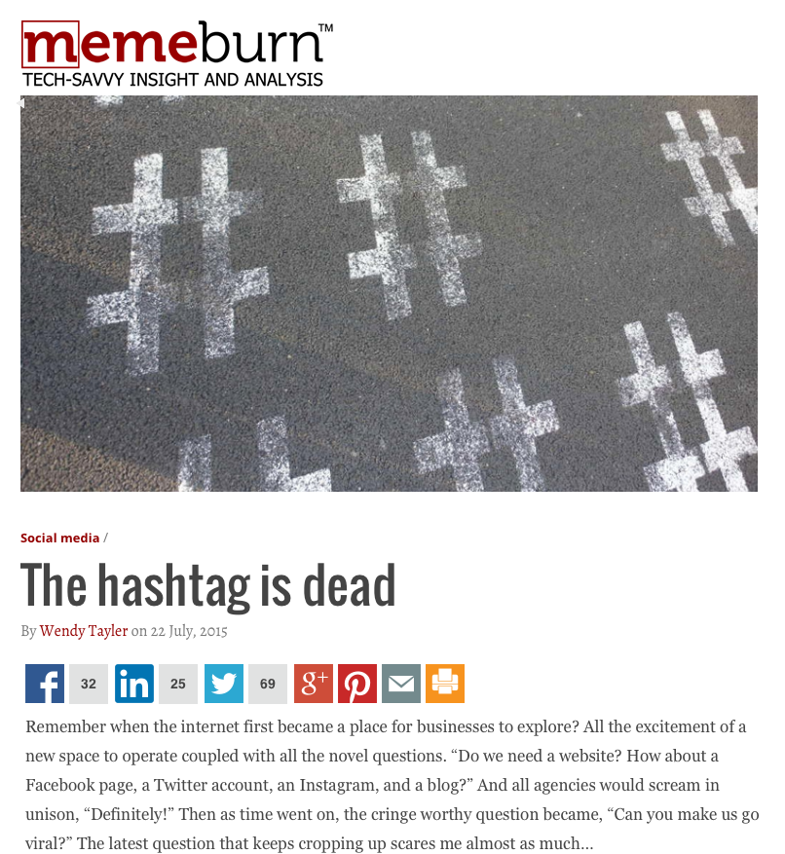
Notes:
http://memeburn.com/2015/07/the-hashtag-is-dead/?utm_source=feedburner&utm_medium=email&utm_campaign=Feed%3A+memeburncom+%28memeburn%29
The hashtag is deadBy Wendy Tayler on 22 July, 2015
Remember when the internet first became a place for businesses to explore? All the excitement of a new space to operate coupled with all the novel questions. “Do we need a website? How about a Facebook page, a Twitter account, an Instagram, and a blog?” And all agencies would scream in unison, “Definitely!” Then as time went on, the cringe worthy question became, “Can you make us go viral?” The latest question that keeps cropping up scares me almost as much…
“What hashtag will we use?”
The mighty hashtag. A genius concept for compiling and monitoring specific topics on social, suggested by Chris Messina in 2007 as a tool for grouping content. But have we truly considered the purpose of this feature in 2015? With all the advanced tracking capabilities and tools these days, is the hashtag as important as it once was?
Considering that our attention spans are getting shorter with the increase with online noise – is it smart to create two different links in a message? If we want consumers to click on something, surely the call to action link is more vital than the hashtag to read a stream of tweets or posts?
When was the last time you clicked on a hashtag on Twitter to see who else was using it? I can’t remember the last time I did. If something interests me enough, I’d prefer a link to further information. In fact, even on our personal capacities, has the hashtag not lost its real purpose and simply become a noisy addition to a list of random words to accompany #selfies?
I’m certainly not saying there is no place on the internet for the beloved pound key. But it needs to have context that counts. An example of contextual relevance is the #RhodesMustFall trend.
When a tweet or movement needs a wider context, the hashtag is most certainly a valid option to include. And on occasion, a hashtag can even become a brand in itself – like #RunJozi. The tricky part of this approach is that every business wants their hashtag to become a brand, have a voice, stand on its own two feet and evolve into a self-sustaining element that will carry the story. Businesses expect a lot of time and effort to be put into the almighty campaign hashtag – something that will never see the light of day again. It’s our job to educate clients about the importance of content, context, and the call to action that should be the focus of social sharing – not the hashtag.
The more hashtags I see, the more noise I hear with no real strategic purpose. We know that although the Twitter character limit is 140, the most well received ones are less than 100 – we crave simplicity. The shorter the better – our brains don’t need a sea of information washing over them in an age where “we’re creating as much content every two days to equate everything created from the beginning of time until 2007” according to Google’s Eric Schmidt.
So there’s some #FoodForThought.

Slide 21
Notes:
http://www.wired.com/2014/04/this-is-the-end-of-facebook-as-we-know-it/?mbid=nl_wired_04152014
FB, the company that makes billions from connecting people to each other, is about to make it harder to have a conversation. In the coming weeks, FB’s mobile app will be losing its chat feature, a move that will no doubt annoy many regular users. But the gutting likely won’t end there. According to many FB watchers, the end of chat is just the first cut in what could eventually lead to the end of FB as a single, unified app altogether.
The move is a crystal clear indication that FB is truly serious about splitting its service out into a constellation of mobile apps FB notified users and confirmed to the press yesterday that instant messaging functionality will be disappearing from its iOS and Android apps in the coming weeks. If users want to keep chatting, they’ll have to download Facebook’s separate Messenger app. It’s one thing to roll out specialized apps like Messenger, Paper, and Camera as optional alternatives for using Facebook, but quite another to force the issue and risk a real sacrifice in user engagement. Some people will upgrade to the Messenger app right away; many others will not. The net result, at least in the short-term, will be fewer people to chat with. Why would FB make that kind of sacrifice?
The resounding consensus among the FB experts I talked to is that the company is finally making the jump to thinking and acting like an app maker, a software company the keeps functionality narrow and targeted. While users may grow attached to services that work the way they’re used to, like the full-featured FB app, the growing Silicon Valley consensus is that people really want a more bite-sized future.
“In mobile we see simple, clear, snackable experiences winning,”. “When you introduce complexity, it can dilute the overall experience.”
FB: A 2nd-Class Experience FB itself has said its flagship app dilutes the messaging experience, which is why, according to the company, users reply to messages 20 percent more in the Messenger app than in the main Facebook App. Facebook CEO Mark Zuckerberg himself has complained that chat inside the Facebook app is a “second-class thing.”
In a way, everything inside the FB app is a second-class thing. That’s why the company has been steadily breaking out big chunks of functionality into separate apps over the past two years.
“The FB experience is 3 experiences in one,”. “One is photo sharing; the wall, which is news; and the 3rd is CMN. And they’ve broken that up into 3 applications.”
For photo sharing, FB has both Instagram and the Facebook Photos app. For news, it has Paper. And for communication, it has Messenger.
Building the Escape Pod It’s enough to make one wonder what functionality will be left in the core Facebook app in a few years, once the company has unbundled everything. In mature markets like the U.S., FB’s user base has essentially stopped growing. Meanwhile, as users move from desktop FB to mobile FB , they’re not necessarily using the product as much. Instead, they sometimes turn to competitors like SnapChat and one-time competitors like Facebook-owned WhatsApp.
“A skeptical view of the decisions is that this is FB is trying to build an escape pod to a better place as the mother ship starts to stall out,” says Eric Eldon, co-founder of Inside FB, former editor-in-chief of TechCrunch, and a longtime journalist. “A gentler one is that they’re just trying to solidify usage of a part of FB that has a lot of unrealized potential … . My guess is that they’re worried about long-term trends around the core FB experience and see the popularity of rival messaging apps interfering with FB in some sort of deadly way.”
Either way, the move is a crystal clear indication that FB is truly serious about splitting its service out into a constellation of mobile apps. There’s no question FB’s decision to end chat in its flagship app will be a huge near-term blow to activity levels on its chat network. The FB app is widely installed, ranking among the most downloaded apps on both Apple and Google’s app stores. And every time anyone opened that app, they were logged in to Facebook chat — until now.
Of course, having bought WhatsApp, FB can afford to take a short-term hit in chat. After all, it just acquired around 500 million messaging users. The time is now ripe for FB to transition from being an omnibus social networking website to a factory that churns out compelling social apps, all united on the backend by the same social graph. By relinquishing all those chat users, at least for now, who won’t migrate from the FB app to Messenger, the company is making clear it won’t let today’s priorities and profits hold back tomorrow’s innovation. If FB can continue to make bold calls like this one, it will undermine the idea, commonly held in technology circles, that the dominant innovators in one computing era almost inevitable are blindsided by the next.

Slide 22
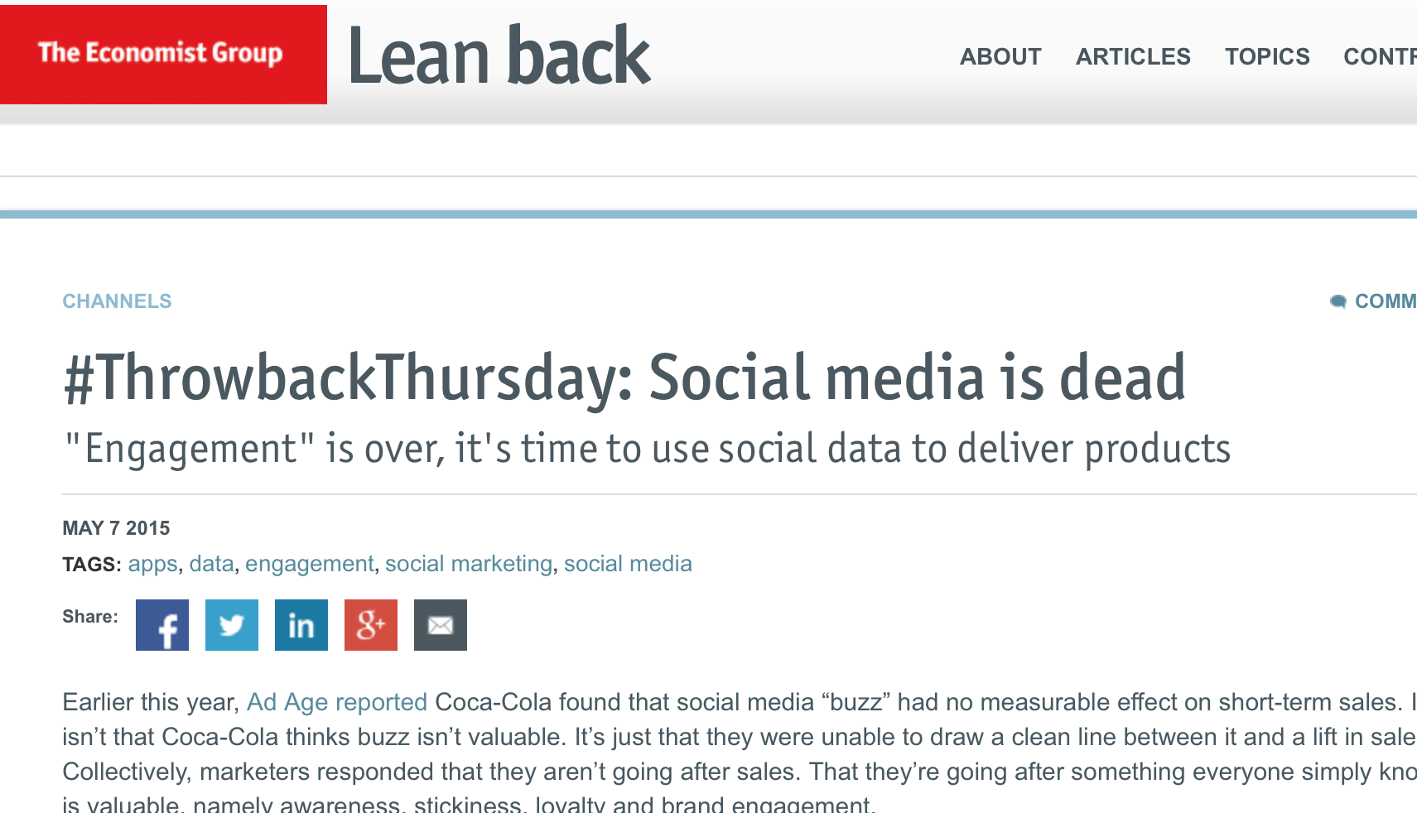
Notes:
http://www.economistgroup.com/leanback/channels/tbt-social-media-is-dead-josh-sinel/

Slide 23
Notes:
CHART OF THE DAY: Mobile Messaging Is Poised To Overtake Social Networks
NOV. 14, 2014
Facebook announced this week that its standalone messaging app, Facebook Messenger, has already surpassed 500 million monthly active users. It’s just one part of a growing trend among users, who are spending more time in messaging apps than ever before.
Based on Flurry data charted for us by BI Intelligence, the top 4 messaging apps are experiencing incredible growth compared to the top 4 social networks, and will likely overtake those social networks within the next few years. Those messaging apps — WhatsApp, Snapchat, LINE, and WeChat — are all growing their user numbers at a quarterly rate of 15% or higher in 2014. But that’s because messaging apps are much more than just texts: You can play games, share news and videos, call, and even send money to each other.
Read more: http://uk.businessinsider.com/chart-of-the-day-mobile-messaging-is-poised-to-overtake-social-networks-2014-11?nr_email_referer=1&utm_source=Sailthru&utm_medium=email&utm_term=Tech%20Chart%20Of%20The%20Day&utm_campaign=Post%20Blast%20%28sai%29%3A%20CHART%20OF%20THE%20DAY%3A%20Mobile%20Messaging%20Is%20Poised%20To%20Overtake%20Social%20Networks&utm_content=COTD?r=US#ixzz3NrAqoPoz
%29%3A%20CHART%20OF%20THE%20DAY%3A%20Mobile%20Messaging%20Is%20Poised%20To%20Overtake%20Social%20Networks&utm_content=COTD?r=US#ixzz3NNvqm37t
Why social media is losing its sparkle http://www.imediaconnection.com/content/36317.asp
Wave goodbye to all those social media gurus. They're about to head off into the sunset. And that's a good thing.
this is the yr that social media will fade into the background. It's not that social media is going away. It's just that it's fading into the background, Social media is the new wallpaper, a highly predicable moment many of us have been waiting for.
Whenever a significant new digital channel develops, it inevitably begins its lifespan as a bright shiny object. The turn of this century was all email, all the time. Email marketing was the new thing that dominated the digital marketing conversation for close to 10 years.
Then, oooh! Search! Paid search! SEO! Search engine conferences were the industry's largest events. The one I was formerly involved with, the biggest one there was, recently rebranded twice: first as a "search and social media" conference, then as a "digital marketing" event.
See where this is going? Email and search now both enjoy wallpaper status. They've faded into the background. This is absolutely not meant to diminish the importance or significance of either as a marketing channel. Search and email still are significant, impactful, and effective. "Wallpapering" is a sign of maturity and essential integration into the larger marketing org.
Social media is finally mainstream, not a novelty. (Remember when having a website was a novelty?) Social media has been departmentalized, strategized, and budgetized –
We're seeing the industry shifts that corroborate this. It's not just conferences that are rebranding and shifting their go-to-market strategies. Social media software vendors, SEOs, and email providers are all scrambling to reposition as content marketing purveyors. Their offerings are essentially the same as they were before, but this new positioning is more topical and more broadly relevant.
Content marketing is the new term on everyone's lips. As an analyst, I'm seeing (and hearing) that it's top-of-mind with clients and technology vendors, at conferences, seminars, and trade publications -- everywhere, in fact, digital marketing is discussed. There's a sudden plethora of "content marketing experts" blathering on about the topic who you never heard of two weeks ago. "Content is king" is new all over again, Sound familiar? It should. Content is where email was. It's where search was, and one day, it will be where social media is headed: fully integrated into marketing -- not a nice-to-have but a must-have.
Rebecca Lieb is an analyst of digital advertising and media for Altimeter Group.
Read more at http://www.imediaconnection.com/content/36317.asp#I4KD1Wg0yJHHX8cg.99

Slide 24
Social media is like teen sex.
Everyone wants to do it.
No one actually knows how.
When finally done,
there is surprise it's not better.
-Avinash Kaushik, Google analytics evangelist
Notes:
We start with a quote from Avinash, a Google analytics evangelist. He says here that “social media is like teen sex. Everyone wants to do it. No one actually knows how. When finally done, there is surprise it's not better.” Many marketers have been jumping blindly into the social space rather than really understanding how social is impacting their consumers and their business. Gaining this understanding helps shape a brands approach to social, and will ultimately provide the guidance and direction for a successful strategy, and as a result drive long term business results.
But the one truism marketers have to realize upfront, they do not have the once enjoyed, tightly held, control of their brands anymore. In this environment you need to operate on a new set of standards and communicate with your consumers in THEIR sandbox… because, rest assured, the conversation is happening with or without you. But the good news is, by properly playing in this space, you can position your brand for prosperity.

Slide 25
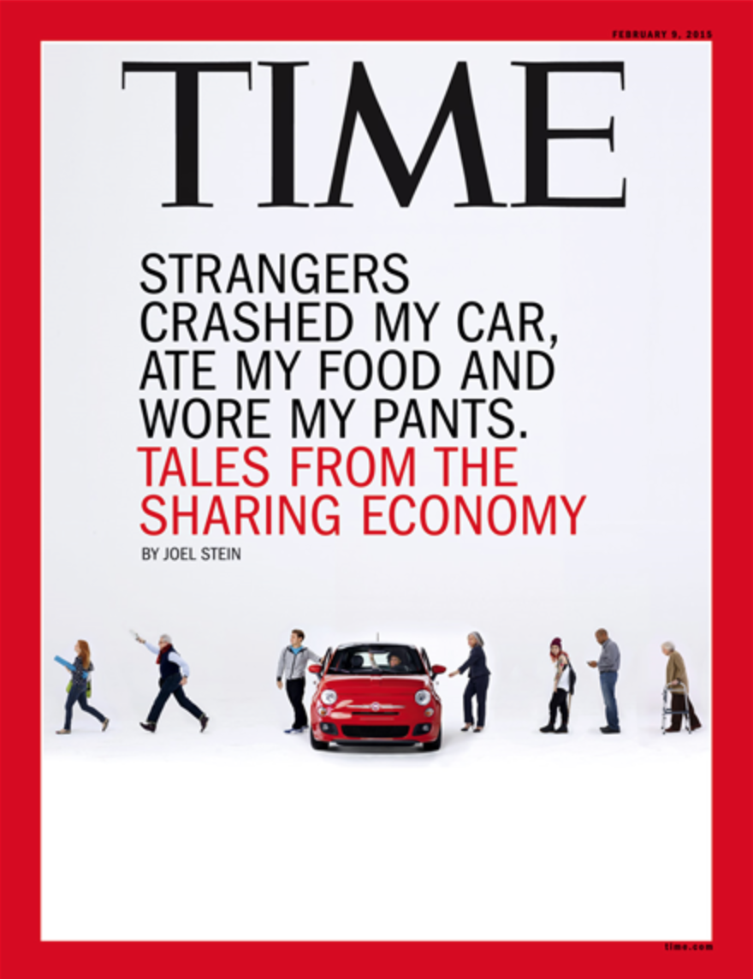

Slide 26
“The real message of media today is ubiquity.
It is no longer something we do,
but something we are part of .”
Marshall McLuhan in Wired, February 1996
Notes:
http://yoz.com/wired/2.01/features/mcluhan.html
Feb 1996- Channelling McLuhan - The Wired Interview
Scholars agree that Marshall McLuhan's earliest books were written by him, but there is mystery and uncertainty about who really wrote his subsequent works. McLuhan would lie on a couch, head on a pillow, and spout ideas for hours. Sometimes assistants would transcribe as McLuhan dictated, sometimes they would later write down what McLuhan had said and sometimes they would write down what they thought McLuhan had said. Somehow, books were assembled from these notes and recollections, and then McLuhan signed his name to them. This indefinite manner of creation was never a problem for McLuhan, who often insisted that facts were not as important as fallacies.
The fallacies of this interview with McLuhan are as follows: About a year ago, someone calling himself Marshall McLuhan began posting anonymously on a popular mailing list called Zone (zone@wired.com). Gary Wolf began a correspondence with the poster via a chain of anonymous remailers. McLuhan (who would have been 84 this year) said he now lived in a beach town in Southern California named "Parma." (This town does not exist.) One tiny hint after another, confirmed by third parties close to McLuhan decades ago, convinced Wolf that if the poster was not McLuhan himself, it was a bot programmed with an eerie command of McLuhan's life and inimitable perspective. After many rounds of e-mail, the conversation got down to the meat of the matter: What does McLuhan think about all this new digital technology?
Wired: Do you still believe that the medium is the message?
McLuhan: The real message of media today is ubiquity. It is no longer something we do, but something we are part of. It confronts us as if from the outside with all the sensory experience of the history of humanity. It is as if we have amputated not our ears or our eyes, but ourselves, and then established a total prosthesis - an automaton - in our place.
What happens when you see yourself outside yourself? It is disconcerting, like a hall of mirrors. A character in Dickens is a representation of a social role, but a modern movie actress who tries to play a role will seem old-fashioned. To cope with this, actresses have cooled themselves way down, become numb blanks. Thus today's stars are totally tranquillised. The smart thing for a girl nowadays is to play numb. Dumb actresses used to be in demand; now numb actresses are in demand. Rigor mortis is de rigueur.
Postindustrial man has a network identity, or a net-ID. The role is now a temporary shift of state produced by a combination of environmental factors, like in a neural net-work. This possibility has always been latent in the concept of role, but in the machine age this was perceived as a danger, while today it is simply a game - we no longer see shifting roles as dangerous and taboo and therefore theatrically compelling. Rather, we follow these shifts as if we were doing a puzzle or kibitzing a chess game. Yes, the medium is the message, but this does not mean and never meant that the content of the medium is a conscious reflection on itself. The medium is the message because it creates the audience most suited to it. Electronic media create an audience whose shifting moods are as impersonal as the weather.
Do you watch much TV, and what do you watch when you do?
The only good TV is live TV. I had three ideas for live TV shows. My first idea came back in the early '70s. It was called Up Against the Wall, and was almost produced. Contestants were to have explained to the audience how they got into a financial pickle. The more entangled their financial disaster, the more energetically the audience would applaud. At the end of every episode, a check would be issued to the most dismal contestant. This emphasis on misfortune would have been appreciated by advertisers, since they need a big dose of "bad news" in all programs in order to balance the "good news" in the ads. If TV actually were to broad- cast more good news, as some cultural reactionaries want, the advertising market would collapse, and the ensuing economic crisis would probably lead to some sort of popular dictatorship, which they do not want.
I wanted to follow this up with a show called Hey, Good Looking. Similar in format to Up Against the Wall, it would have invited the viewing audience to share the suffering of ugly people. These ugly people would explain how they had been set back in life by their unattractive physical appearance. Then, the home audience would vote by telephone for the ugliest contestant, who would receive free plastic surgery. After the surgery, the contestant would come back and explain to the audience how his life had changed. The success of this show would have shown how important public displays of suffering are on television. This show, too, was never financed because of the sensibilities of network heads. But it was ahead of its time.
My other idea for a show was the most successful. I had an idea for a program that would break up the television screen into many individual segments. Any attempt to understand the show as a linear narrative would have been frustrated, and my audience would have had no choice but to accept the whole picture as a kind of music for the eye, which is what television actually is, though most people aren't aware of it. The theme for the show would been "the movies," thus proving my theorem that the programs in a new medium are always revivals of an old medium.
I made this proposal to several friends and it was finally picked up by the producers of The Hollywood Squares. (The Hollywood Squares is the US version of Celebrity Squares.) If you watch the credits closely after the closing music, you will see my name. I enjoy this show very much because it remains a sophisticated commentary on the nature of television. By filling the space of the TV with a mosaic of close-ups, Hollywood Squares hypnotises its audience by paralysing their senses and numbing their eyes to other distractions. The movie world is literally chopped up into nine squares, each of which contains a close-up. The theme music is the ticktock of a hypnotist's watch. This is very clever and dangerous. Few people understand how Hollywood Squares was the direct predecessor of MTV; the link is that Hollywood Squares was the first show to comprehend my dictum that TV was music for the eye.
So, what kind of TV show would you do today?
I no longer want to create a TV show. TV should be watched, not made.
Do you think privacy and anonymity are being eroded in the digital age?
Don't be fooled by "anonymity." There is no such thing, since every node in a commu-nication system must have an ID. Concerns about privacy and anonymity are outdated. Cypherpunks think they are rebels with a cause, but they are really sentimentalists.
In the '50s, men were crying about the "mass" man and spilling tears over too much anonymity. And they were right, or more right than the cypherpunks. Factories and corporations gave men roles, not souls. Industrial society was anonymous. Cities, factories, secret ballots with mechanical polling booths - that's anonymity. The Big Brother bogeyman of the machine age used technology to enforce anonymity and prevent anybody from doing his own thing.
The era of politics based on private identities, anonymous individuals and independent citizens began with the French Revolution and Napoleon's armies (a product of the popular press) and ended with Hitler (the product of radio). The cypherpunks are still marching to the same martial music. You think private individuals and mass industrial society are opposites? They are part of the industrial configuration. Instantaneous electronic society gives everybody an identity - which we all want, yet which we all want to lose - while putting almost intolerable pressure on our sense of privacy.
Privacy disappears in the simultaneous stimulation of our patterns of thought.
Then why do you send these messages via an anonymous remailer?
I am not anonymous, but have simply changed my ID. Think of it as a brand. An old brand goes stale, or ends up controlled by a competitor, so you think up a new one. Wyndham Lewis taught me that the secret of success is secrecy, and I used to think he was joking. But now I realise and am trying to demonstrate that these anonymous remailers are among the great publicity devices of all times. They provide a unique ID that is very glamourous and easy to distinguish from a common name. You change it at will, and it even incorporates the sacrificial element of naming and renders tabloid-type identity exposés unnecessary.
What's your take on media juggernauts like Microsoft? Should they be allowed a stranglehold over electronic media?
We fear that the owners of the monopoly will crush us, but this never happens. In a flash, the monopolist's products appear out of date, and competition in their particular industry becomes irrelevant because the whole basis of moneymaking has shifted to a new area. As the pace of technological change speeds up, shifts in economic power increasingly seem like magical flip-flops produced by luck. The old logic of monopoly - centralised stranglehold - no longer works. The attention of consumers can shift instantly and make the most profound investments obsolete in just a few years, soon to be sped up even further. We will see economic empires crash within hours, and new ones arise just as quickly. The task of the economic manager now is to try to hold monopolies in place just long enough for economic transactions to occur. The capitalist understands that to improve competition, he must encourage monopolies.
What would you do about the inequality of the technological haves and have-nots?
Equality is an industrial ideal, along with voting, time clocks and the minimum wage. Machines promote equality; that is their downfall. The organic unity of pastoral times was replaced in the machine age with fragmented individuals, who could compete with each other. This unequal competition gave a foundation to the idea of equality. The industrial age transformed millions of farmers into mass workers and mass consumers. Only by transforming millions of farmers into a mass of workers and street riffraff could machines succeed in smearing the doctrine of equality around the world.
The hubbub now about equality is actually a nostalgia for machines. Our environ-ment has been transformed into a single omnipresent network that embraces and encompasses individuals of unequal status. Machines - extended to their limit and transformed into a single omnipresent network environment - will move into sacred and ritual environments. Recognised as an extension of ourselves and properly managed by a priestly class, technology inspires rituals, performed out of something like love. This development restores machines to their original totemic purpose. Whereas Marx recognised machines as "the dead hand" of the past, the electronic network could make this totem (an amputated body part, you'll notice) into a shrine for ancestors. Machines are gods not simply because they are powerful, but because they are the living embodiment of our ancestors. The Christian and the pagan world views have come together in an attitude of unconditional love of machines.
Is the book dead?
The book is not dead. When the book is finally freed from its aura of authority and its "soulfulness," it will return as a convenient interface. Just as the advent of printing created a market for medieval culture, the advent of the Net will build an audience for book authors. The body of the book, to mis-paraphrase a Frenchman, will be liberated from the soul of the book. In the age of electronic communication, invest in books. This is sound advice for people whose ears have replaced their eyes.
Sven Birkerts [author of The Gutenberg Elegies: The Fate of Reading in an Electronic Age], an unintentionally funny writer, has been worrying that electronic networks might cause the popular audience for James Joyce to shrink. Last time I dropped by the Parma Dillons outlet (which recently replaced a musty store full of paperbacks, proving that books are a growth industry), I noticed that Finnegans Wake was selling just about as many copies as it always did.
You were always fascinated by advertising. Do you think the Net will change advertising?
Let me tell you about the economy of Parma, where I live. It has a secret economy, a mixture of software firms and natural-juice franchises whose factories are the unused play rooms and converted triple-car garages of a suburban lifestyle that no longer holds interest. The juice franchises in Parma do not actually squeeze juice - this is handled remotely by friends and relatives of the franchisees, who strike deals with national distributors of organic produce. The franchise handles the marketing campaign: developing slogans, bottle designs, billboards, and TV commercials.
You see, the advertising is far more expensive and difficult than the juicing. This has been the case generally with advertising for decades: by now it should be obvious that a product is merely an inducement to the consumer to purchase the advertising. The Net will only further this movement.
It is quite conceivable to me that a juice franchise could stop charging for its beverage altogether and simply give it away to people who pay to receive the advertising.
It would appear that instead of the advertising promoting the product, the product promotes the advertising. But that is not exactly right. Actually, the product promotes the consumer. The advertising gives the group of consumers its identity and raison d'[delta]tre, and with a little bit of priming the group then begins to interact and entertain itself. The existence of the community of consumers gives other individuals (who are alerted by the advertising) an incentive to participate. The anxiety of the outsider can be overcome by consuming the product, at which point he automatically becomes part of the community. I am quite certain the product could never be eliminated entirely, but, again, it could be given away for free to people who purchase the advertising.
Would you consider doing something more extensive, perhaps in new media?
I am open to business opportunities of the right sort. I never let the failures of my past life deter me from new failures. At the moment I am thinking of the Dew-Line newsletter. The problem with Dew-Line, frankly, was that it was too much work, and though I was angry at Tony Schwartz at the time of its demise, I have since realised that it wasn't his fault.
Did you ever see the deck of cards we made? The idea was to create a modern tarot - not in the occult sense, but rather a series of puns and unrelated images that would spur sclerotic executives to creative thinking. Turn a card and then describe how it relates to the current situation. I realise now that this was too far out. My favourite card was the one that showed a picture of a girlie with pasties over her breasts. The axiom on the card said, "Thanks for the mammaries." I really believe that if the execs had given it half a try, this card alone would have cured their ulcers. Today, we are just swimming in information. It is a sort of lactic sea.
In the emerging global village, isn't it imperialistic to expect everyone to have the same values (ours), obey the same laws (ours), and communicate in American English?
America is no longer a global power - it's a global brand. America as a brand stands for liberty, money, and sex. That three-way combo is hard to beat. Certain countries have successfully transformed themselves into brands already. Take France. Can you imagine a world without France's wine, cheese, "culture" (a fuzzy amalgam of books, fashion, and accent) or "romance" (kisses on crowded streets, et cetera)? France earns vast amounts of money from its Frenchness, which has little to do with France as a military or bureaucratic structure, except to the extent that the French state functions as an overgrown tourist bureau, which is increasingly the case.
America should take a lesson in global branding. To succeed as a brand, America should shrink its army, reduce its diplomatic corps, cut back its public participation in political meetings and summits. This will allow American products, from movies to soft drinks to computers, to become far, far more valuable and powerful.
Is the Web hot or cool?
The Web is cooler than television, which is much cooler than print. So much participation is required on the Web that no coherent, convincing, sharply defined characters can be created without slipping over into comedy or conspiratorial paranoia. Conventional media companies, like Time magazine, are going to have to get this right if they want to succeed. Zen Buddhism, which is very cool, flourished in the '50s when the spread of television created a need for people to cool down their personalities; it will again be a growth industry in the late '90s.
Success in a cool medium takes one of two forms. You are either a moment of supreme wit - popular but transitory - or you become part of the landscape. To become a feature of the landscape is very difficult in a cool medium. Your brand must always be present in the back of the user's mind. Everything they see, no matter how unrelated, should give them "memories of you." Any moment of questioning or hesitation (and there will be many of these moments, since cool media require lots of participation and demand many choices) should call forth the suggestion, "Click here." To become part of the landscape in a cool medium, you must connect on a mythic level to the structure of the medium.
Impossible? It works for Jesus, who is "always on my mind" as the Protestants say in their church and country music.
Do you have your own Web page?
No, I don't have my own Web page. I am practicing a discipline that leads to the next stage of media: that of disappearance. "The secret of success is secrecy." A program that calls forth active participation will always have a stronger impact in a cool medium. That's why gurus live on mountain tops, eh?
What did you make of that media black hole, the O. J. trial?
Marcia Clark asked the jury to follow drops of blood down the sidewalk, just like letters on a page or like a sequence of dots or full stops. But the jury was in the cool tactile world of television, where everything happens at once, not the hot world of print, where things follow logically, so they did not want to tack a sentence on at the end of the full stops. A verdict of innocent is easier, cooler, than a verdict of guilty, because no proof is required to find somebody innocent. They found O. J. not guilty but they found the idea of proof very guilty. Nothing can be proved on TV. Of the five criminal trials that were popular over the last few years, only the one that was not on TV - Mike Tyson's - resulted in a conviction. All the other defendants were on TV and were not convicted.
What would you say your contribution was to the business world?
I was a business consultant. I did OK making speeches to executives and handing out tips to magazine types. Howard Gossage helped turn me on to that - "Save the world and fly first class" was his motto. But the consulting business got very bad as the obsolete idea of efficiency failed to disappear.
The worst thing for any organisation is efficiency. You get moving very quickly and you end up in the wrong place.
The key to business in the aural/tactile space of the 21st century will be ineffi-ciency, where inefficiency means a multiplicity of inputs and outputs.
Tangents are key. The best businesses in the electronic age will be everywhere at once; i.e., they will be an essential part of the landscape. Their message will be vague but ubiquitous. Not discursive, but iconic and ironic. Only when there can be too many meanings and many uses for a product will it be a success. If it works, it's obsolete, I used to say. But I heard a new slogan recently that appears to be perfect for this new economy: "Welcome to the future - it's broken."
This is not said in a tone of despair but in a bright, happy voice. Being broken is more productive. The difference between being productive and wasting time is disappearing, and we are returning to a preindustrial config-uration. Businesses that imagine themselves to be efficiently pursuing their goals will wake up one day and find themselves utterly alone, profitless and broke. This explains the current "merger mania." The idea of "synergy" is illusionary. What these huge companies are really after in combining is inefficiency.
That's why the Net is the premier invention of the digital era. It is not about finding anything. It is about superfluous connections and wasting time. As you know, only the young, the primitive and the eccentric waste time. That is why all the most useful inventions come from them. They are not bound to be productive, and can thus waste time pursuing the unpromising to find the truly new. The efficiency of the machine age cannot discover anything worthwhile now.
Gary Wolf (gary@wired.com) is the executive editor of HotWired. He and Michael Stein are the authors of Aether Madness: An Off-Beat Guide to the Online World.

Slide 28
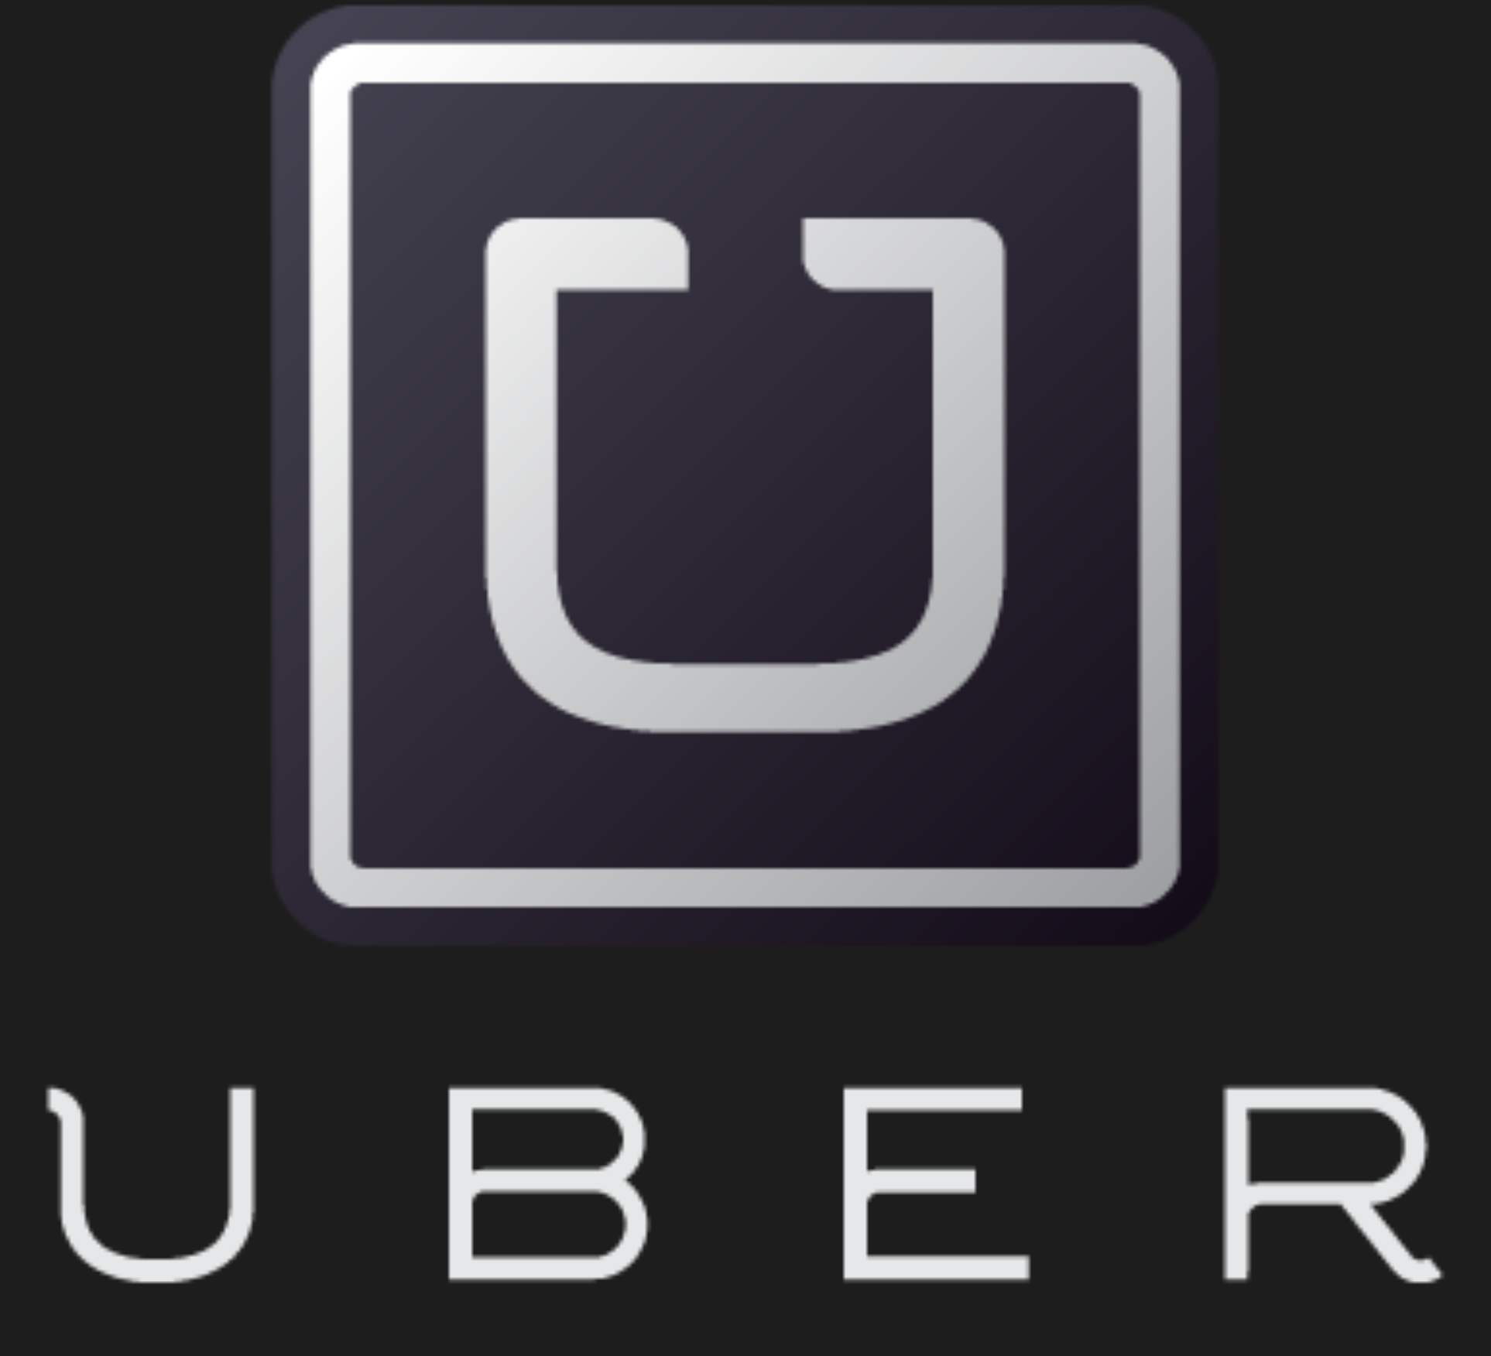

Slide 29
The world’s largest taxi company owns NO vehicles

Slide 30
Notes:
http://ebm.cheetahmail.com/c/tag/hBWJUvGAukDJ-B9GrklDqa-2TNb/doc.html?t_params=EMAIL=pbelang%40uottawa.ca

Slide 32
Facebook, the world’s most popular media owner creates no content

Slide 33
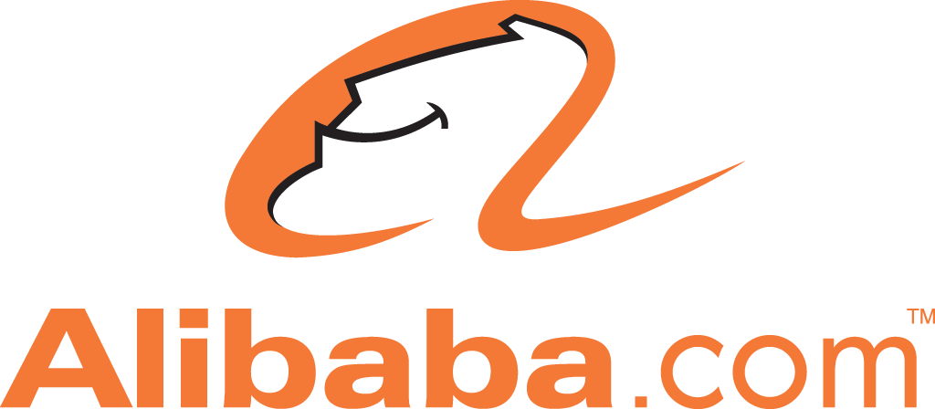

Slide 34
Alibaba, the most valuable retailer
has NO inventory

Slide 36
The world’s largest
accommodation provider
owns NO real estate

Slide 37
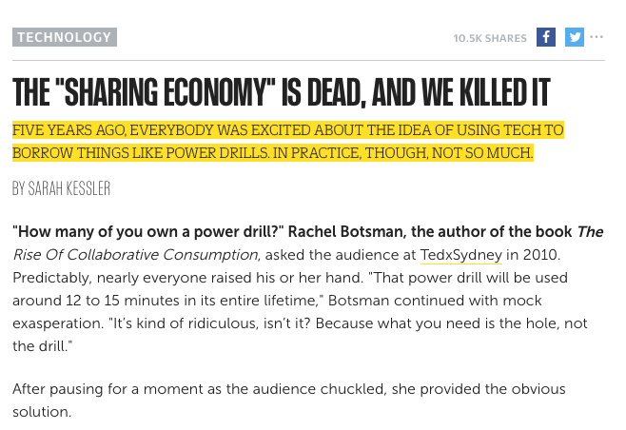
Notes:
THE "SHARING ECONOMY" IS DEAD, AND WE KILLED IT
FIVE YEARS AGO, EVERYBODY WAS EXCITED ABOUT THE IDEA OF USING TECH TO BORROW THINGS LIKE POWER DRILLS. IN PRACTICE, THOUGH, NOT SO MUCH.
http://www.fastcompany.com/3050775/the-sharing-economy-is-dead-and-we-killed-it?utm_source=mailchimp&utm_medium=email&utm_campaign=fast-company-weekly-newsletter&position=1&partner=newsletter&campaign_date=09182015
BY SARAH KESSLER
"How many of you own a power drill?" Rachel Botsman, the author of the book The Rise Of Collaborative Consumption, asked the audience at TedxSydney in 2010. Predictably, nearly everyone raised his or her hand. "That power drill will be used around 12 to 15 minutes in its entire lifetime," Botsman continued with mock exasperation. "It’s kind of ridiculous, isn’t it? Because what you need is the hole, not the drill."
After pausing for a moment as the audience chuckled, she provided the obvious solution.
"Why don’t you rent the drill? Or rent out your own drill to other people and make some money from it?"
Back then, this version of what Botsman called collaborative consumption, or what would become better known as "the sharing economy," seemed like a warm and fuzzy inevitability. American consumerism had been tamped by one of the worst recessions in history, concerns about the environment were growing, and new online networks provided a connective thread that could help us get by on less by sharing things with our neighbors. "We now live in a global village where we can mimic the ties that used to happen face to face, but on a scale and in a way that has never been possible before," Botsman explained, and these new systems allowed us "to engage in a humanness that got lost along the way." We were now, she said, experiencing "a seismic shift from individual getting and spending towards a rediscovery of collective good."
“EVERYTHING MADE SENSE EXCEPT THAT NOBODY GIVES A SHIT. THEY GO BUY [A DRILL]. OR THEY JUST BANG A SCREWDRIVER THROUGH THE WALL.”
Already there were a bevy of startups with dreams of facilitating the community-shared power drill. Ecomodo had launched in 2007; Crowd Rent, Share Some Sugar, and NeighborGoods in 2009; Thingloop, OhSoWe, and SnapGoods in 2010.
The media loved the idea. Entrepreneur magazine named NeighborGoods one of its 100 most brilliant companies of 2011, and it’s hard to find a publication that covers technology that did not mention the idea of sharing the power drill. Many of them cited the example directly: Time magazine explained that "renting a power drill via SnapGoods for the one day you need it is a lot cheaper than buying it." The Guardian, when introducing NeighborGoods, said that the idea made sense "with the average power drill used only about 12 minutes per year." The New York Daily News told New Yorkers they could "save countless ways by borrowing items, like a power drill, from neighbors." And Wired asked, "If I can avoid buying an electric drill for that one job, or some temporary dinner-party chairs, or a car I will drive maybe a couple of times a month—well, why wouldn’t I rent them from you?"
Even companies that weren't renting power drills proselytized the theory. "There are 80 million power drills in America that are used an average of 13 minutes," Airbnb CEO Brian Chesky told the New York Times in a 2013 column about the sharing economy. "Does everyone really need their own drill?"
There was just one problem. As Adam Berk, the founder of Neighborrow, puts it: "Everything made sense except that nobody gives a shit. They go buy [a drill]. Or they just bang a screwdriver through the wall. »
Of the eight sites listed above, only NeighborGoods is still around—after it ran through its seed funding, it was salvaged by an investor with a personal interest in the idea. About 42,000 people have signed up, though fewer than 10,000 are active. While sites like Airbnb and Uber became giant companies, the platform on which we would share our power drills with neighbors never took off.
Instead of platforms that would inspire human interaction and create less waste, what emerged were companies that awkwardly fit into—and at times completely twisted—this vision of neighborhood sharing. The "sharing economy" grew to include an odd menagerie of companies with little in common. Groupon "shared" the collective action of tipping a deal. Kickstarter "shared" a similar funding goal among many contributors. Sites like Airbnb "shared" homes, but charged by the night, like a hotel. Gig economy platforms like Uber and Handy "shared" the labor of independent contractors paid by the hour or mile. Netflix somehow even managed to fall under the sharing economy umbrella at one point.
Though a few pieces of the original "sharing economy" promise survived, like peer-to-peer car-sharing services RelayRides and Getaround and bike-sharing site Spinlister, today they are largely divorced from the concept of a global village. Somehow, when a major hotel chain forms a partnership with a $50 billion company, it is able to pass the move off as joining the "sharing economy."
But the real sharing economy is dead.
It was a beautiful idea that struck hard, but when it died, nobody seemed to notice (some publications continued to cite SnapGoods, for instance, a year after it shut down). And nobody seemed to ask the question of how an idea that everybody loved so much, an idea that made so much sense on a practical and social level, morphed into the pure capitalism that it is today.
For Gary Cige, who founded a peer-to-peer rental platform called Zilok in 2007, inspiration struck after he actually did need a power drill on a Sunday in Paris. For Ron J. Williams, the founder of SnapGoods, it was a motorcycle he rented from Craigslist. For Keara Schwartz, the founder of Share Some Sugar, it was a ladder.
The story behind neighborhood sharing services, no matter the object, often goes something like this: "I didn’t know how many times I would need [the ladder], so I thought, there has to be someone who I can borrow it from," Schwartz says. "I rang a couple of neighbor’s doorbells, and people didn’t have long enough ladders . . . So I went online and I was like, okay, $175 to buy something I’m probably going to just use once. That seems ridiculous. But it was so easy to find something online to buy that I figured oh gosh, it should be this easy to find something in my neighborhood. That’s kind of when the lightbulb went off."
“I WENT ONLINE AND I WAS LIKE, OKAY, $175 TO BUY SOMETHING I’M PROBABLY GOING TO JUST USE ONCE. THAT SEEMS RIDICULOUS.”
The idea of renting to neighbors launched to a flurry of attention and praise.
Williams’s mother took articles about SnapGoods to show her neighbors, and for the first time, Williams felt that she really understand what he did. "We never paid a dime for PR," he says. "We never invested in aggressive marketing . . . but we had just an absurd amount of traffic for a pretty green team doing a startup from the ground up." The site drew about 30,000 visitors per month at its peak, and SnapGoods signed up about 100,000 users. After he appeared on the Today show, for instance, Berk says about 2,000 people signed up for Neighborrow in one week.
But most of these platforms soon discovered a discomforting incongruity between enthusiasm for the concept and actual use.
"Everybody loved the idea. It was like, 'Oh, this is great. I would love to use it,'" says Schwartz. "Then I launched the thing, and it was super-slow adoption."
SnapGoods and NeighborGoods had more people who wanted to lend things than wanted to pay to use them. Share Some Sugar had the opposite problem. Some sites had pockets of items that worked—on SnapGoods, for instance, electronics and photo equipment took off—but it was tough to become the default platform for renting anything. For NeighborGoods founder Micki Krimmel, it seemed like a matter of execution. A change she made right away was removing the option to rent goods, which ensured the platform would truly be focused on neighborhood favors.
"When you’re making something and everybody is like, ‘Oh my god, that’s brilliant. How come nobody ever thought about that before?’ You definitely feel as though you’re on the path to something," Krimmel says. "I am less optimistic about it now, because I’ve seen where the sharing economy has gone. »
"Let me ask you this," Williams says. "For a drill, which by the way now costs $30, and you can get it on Amazon Now and have this thing delivered to you in an hour if you live in New York City—for something worth $30, is it really worth your time to trek potentially 25 minutes to go get something that you spent $15 to use for the day, and then have to trek back?"
For most people on the sharing platforms, the answer was no. The people for whom the answer is yes were unlikely to be using platforms like SnapGoods, which generally attracted upper middle class early adopters who were comfortable with technology. Williams had ideas about how to lessen the pain. Maybe, he thought, he could convince livery drivers to transport goods for a fee when they had empty cars (a great idea, it turns out, that Uber would later embrace). In order to address the problem of more people posting goods than renting them, he refocused the site so that people could advertise the things they wanted. "I need a power drill, do you know anyone?" turned out to be drastically more shareable than "I have a powerdrill!" Eventually that tool illuminated a need to make targeted outreach across social networks easy, which seemed more promising than SnapGoods. He shifted his attention to creating that technology, today called Knod.es, and shut down SnapGoods. Now he is the managing partner of a strategy and product development consultancy firm called proofLabs Group.
“IS IT REALLY WORTH YOUR TIME TO TREK POTENTIALLY 25 MINUTES TO GO GET SOMETHING THAT YOU SPENT $15 TO USE FOR THE DAY, AND THEN HAVE TO TREK BACK?”
Schwartz moved from Cincinnati, where she had founded Share Some Sugar, to New York, and she slowly stopped answering customer service emails until she shut the site down about three years ago.
"We tried everything: Schools, temples, affinity groups, suburbs," Berk says of Neighborrow. "It should work in offices. It doesn’t work there either." After he failed his cofounder’s challenge to get three (yes, three) of the site's thousands of registered users to make transactions, he moved on to another project.
The most successful "sharing economy" startups ended up being those that made the process as efficient and transactional as possible. "What Airbnb did quite well is that the process where you rent a room anywhere is actually quite similar to a hotel room," says Cige, the founder of Zilok. "For peer-to-peer car rental, it’s exactly the same." Cige left Zilok in 2011, four years after founding it. Though it exists, it spun off a more successful car-lending platform called ouicar.com.
Other companies that claimed space under the "sharing economy" umbrella and its halo effect, meanwhile, have transitioned away from that narrative. Lyft may have debuted its service as a more neighborly, peer-to-peer version of Uber—encouraging people to greet their drivers with a fist bump, fuzzy pink mustaches—but now it’s competing on price instead.
Parking Panda once marketed itself as a way to share parking spaces with neighbors, but now many of its shared parking spaces are in restaurants, hotels, commercial garages, and airports. Rent the Runway successfully rents dresses, but from a warehouse full of 65,000 garments, not from stylish neighbors. And Zipcar, acquired by Avis in 2013, successfully changed the way we rent cars, but we’re definitely not meeting each other by doing so. Calling Groupon, Netflix, or Kickstarter a "sharing economy" company at this point almost sounds absurd.
It’s not that these tools and sites aren’t good services or that they don’t make things easier. It’s rather that they have little to do with the original promise of the sharing economy. Really, it’s more of an "access economy," a term Williams used from the beginning. "We hated that terminology," he says of the sharing economy. "Hated it with the heat of a thousand suns. »
For Brendan Benzing, it was a power washer.
"It was daunting," he says of the seven-mile trip to and from Home Depot to rent the tool. "It cost me $90. I knew there were people in my neighborhood who had the item but I didn’t know who they were."
Last year, he and his cofounder, Sebastien Martel, founded MyNeighbor, a platform for renting and borrowing anything. They’re convinced that this time around, things will be different. "It’s not often the company that was first that tends to succeed," Benzing tells me. "It’s the 10th or 13th."
“IT’S NOT OFTEN THE COMPANY THAT WAS FIRST THAT TENDS TO SUCCEED. IT’S THE 10TH OR 13TH.”
About 1,000 people are participating in MyNeighbor’s Seattle pilot.
Maybe the timing is better. Now there are courier services in many urban areas that will whisk your power drill from point A to point B for a minimal fee. Neighborhood social network Nextdoor has scaled across 69,000 communities, proving that neighbors do want to connect. Facebook recently added a feature that makes it easy for people in groups to buy, sell, and trade items. Peerby, the most successful current peer-to-peer rental platform, says it has processed more than 100,000 transactions and has 500,000 users. An article in the New York Times puzzlingly positioned it as a continuation of the trend Airbnb, Uber, and Lyft's business models rather than as an idea that was folded into these businesses from the beginning ("Want a power drill to help you hang those blinds?" the article asked, once again. "It’s just a mouse click away.")
Maybe the sharing economy really has come full circle, and what started as an idea about sharing among neighbors will finally turn into popular tools for sharing among neighbors. What’s certain is that people still love the idea. When Nielsen polled more than 30,000 Internet users, 23% of them said they would be willing to rent their power tools to neighbors.
Even Berk, who stopped looking for funding for Neighborrow in 2009, who believes that the core problem with the idea was not trust, insurance, funding, interface, or anything other than human apathy, is still trying to make the sharing economy work. If someone requests something from Neighborrow that isn’t already on the inventory list and costs less than $250, he will buy it from Amazon, send it to them, and ask them to send it along to the next user who wants to rent it.
"I will never shut it down, ever," says Berk, who now works as a lean startup consultant. "But I couldn’t just live in fantasy town forever."

Slide 38
Notes:
http://www.economistgroup.com/leanback/channels/throwbackthursday-2014-digital-content-newfronts/
#ThrowbackThursday: TV is (not) dead
Highlights from the 2014 Digital Content NewFronts
APRIL 23 2015
TAGS: content, digital, Online Video, TV
Share:
Featured Image
The annual Digital Content NewFronts— the online cousin of the upfronts marketplace where TV networks show off the fall season lineup to media buyers—have become an established marketplace, a sign that online video has matured into a channel of its own. In fact, many of the faces at NewFronts presentations held over the last two weeks were repeat visitors from last year: Sarah Jessica Parker and Nicole Richie were among the celebrities plugging the “second season” of their programs, and many executives focused on how the numbers of views and time spent continue to trend upward.
“We’re at a critical moment for video consumption,” said Yahoo CEO Marissa Mayer. A study released by the Internet Advertising Bureau found professional video made for online distribution has an audience of 52 million adults a month, up 15 percent over 2013. The audience for made-for-online video has overtaken TV news and daytime programming, according to the IAB’s survey.
Amid the open bars and celebrity sightings, a few developments stood out at this year’s NewFronts:
TV is not dead: Several traditional-media companies launched new platforms to channel their video assets, such as Time Inc.’s The Daily Cut and Conde Nast’s The Scene. But most online executives disagreed with Google chairman Eric Schmidt bold pronouncement from last year’s NewFront that online video has already displaced TV.
“The story is not about winners and losers,” said Ron Harnevo, AOL’s president, video. Instead, the online video executives say TV and online video are increasingly dovetailing, with one channel backing up another.
While services such as Hulu and NetFlix stream TV programs online, streaming content is moving into the big TV screen thanks to new devices like Roku and Amazon Fire TV, further blurring the lines. Viewers are not making the distinction between content on a TV screen or on a tablet, and marketers are increasingly following their lead in media plans.
Tony Weisman, CEO of DigitasLBi, singled out the deal between Amazon and HBO that will stream the cable channel’s programs on Amazon Prime as “just one harbinger of the post-TV streaming video market and truly the future of television.”
It’s not all about snacking: Despite acknowledging mobile viewing continues to rise, a number of programmers introduced long-form content that approximates the format of television programs. Several executives noted that viewers are watching longer videos online; Roy Sekoff, president of HuffPost Live, the AOL live video platform, noted the average visit to the channel lasts 20 minutes.
AOL launched Connected, a reality series with 20-minute episodes, while The Wall Street Journal announced the launch of Signal, a video platform that will include both short-and long-form content. Separately, Weisman announced Digitas has formed an alliance with video producers Epic Digital to create exclusive long-form videos for clients.
Habits vary by platform, said Gabriel Lewis, head of AOL Originals; he said AOL saw the viewership data as a sign it’s time to offer more long-form content.
Indeed, some speakers noted the growth in connected TVs—sets with Wi-Fi connections or streaming devices like Roku—is also fueling more consumption of longer-form content. Research released by Tremor Video during the NewFronts showed the bigger the screen, the longer the time spent with online content, said Doron Wesly, head of market strategy. Viewers on connected TVs watched 6.8 hours of longform video content a week, compared to 5 hours of short videos, he said.
How to count an audience: The NewFronts are a soapbox for online publishers to tout ad platforms and metrics, and this year was no exception. But 2014’s NewFronts also saw a renewed interest in measuring online video audiences with metrics comparable to TV ratings, so marketers can move budgets easily between them.
Yahoo announced a partnership with comScore to offer advertisers real-time audience reports using TV-comparable metrics for video, display and mobile ads. Meanwhile, AOL partnered with Nielsen to beta-test an extension of its Online Campaign Ratings that will provide gross ratings points comparable to TV ratings for AOL’s new programs.
While TV and online networks profit, all this could be bad news for cable companies, especially since younger viewers are more likely to be cord-cutting watchers of online content. But they’re also likely to be “cord-never” media consumers, said Wesly.
“People don’t care about the device, what they care about is the content,” he warned marketers. “Your strategy should be ‘I need to be across those screens and I need a partner that will help me optimize it.’”

Slide 42
If you build it
They will……
download it!
Notes:
http://www.mobilecommercedaily.com/beyond-the-rack-exec-if-you-build-it-they-will-download-it
Beyond the Rack exec: If you build it, they will download it
By Brielle Jaekel August 14, 2015
BOSTON – An executive from Beyond the Rack at eTail East 2015 believes that all retailers should introduce a mobile commerce application, but they need to put significant effort into it and not simply launch one for the sake of being mobile.
During the Don’t Leave Money on the Table: Beyond the Rack’s Mobile Q4 Review session, the executive detailed how the digital retailer found that customers were downloading its mobile application with little prompting and now sees 45 to 55 percent of its Monday-through-Friday sales on mobile. However, retailers need to really focus on developing these apps to their full potential, and not simply create an app just to check a box.
“You can not just build mobile sites and check the box,” said Richard Cohene, director of marketing at Beyond the Rack. “You have to build the best mobile site that you can.
“Just always look forward in mobile,” he said. “You do not want to be the one that is the last to the party with Apple Pay, or last to the party with responsive design. “You want to be in front of it because the customers are already experiencing it.”
Mobile apps are key
Beyond the Rack boasts a significant amount of traffic through mobile and is aware of the strong potential the platform offers. Retailers that still have not forayed into developing apps are missing out, but also are those that have created apps without much thought. Mobile apps put forward such a high prospect of increasing sales and engagement with consumers. This will only increase as younger demographics, who have grown up in a digital world, age and start to dominate as the majority of retail customers.
While Mr. Cohene believes that mobile apps are most important, he also noted that retailers using email to connect with users also need to ensure content is appearing as intended. An effective method in guarantee high quality email is through responsive design. The digital retailer switched to responsive emails and saw significant results. Once Beyond the Rack introduced responsive emails, it saw an increase of 14 percent in sales from its daily newsletter.
The increase in email-generated sales and high interaction with its newsletter is extremely important for Beyond the Rack, as 60 % of its revenue is trafficked through emails.
Following the launch of the responsive emails, the retailer did more than just a minor update and completely overhauled the newsletter and email design. This resulted in a 44 percent increase in sales from emails.
Push-notifcations
Mr. Cohene also urges retailers to introduce push-notifications into their app designs. Now that consumers have the option to turn off these messages, retailers know that the users who choose to receive these receive notifications are loyal followers of the brand and a huge asset. Retailers sending out push-notifications to these valued users are also not competing for inbox space via email and will likely not be buried in with many other messages, as most consumers are known to turn off notifications. PayPal is another important aspect of Beyond the Rack’s strategy. The retailers leverages the payment service, as it has large customer-based of loyal followers that trust its platform.
For new Beyond the Rack customers, purchasing through PayPal can make them feel more at ease because they consider the platform to be secure, in turn generating trust for the retailer. “You are not just getting an ease of payment you are actually gaining a trust factor there,” Mr. Cohene said. “For your first time customers who are coming to your Web site, they do not know you. “They do not trust you, you are just a Website that they just want to buy something from,” he said. “PayPal is a little bit of a gap bridged there in terms of building a trust and a loyalty to the consumer that lets the buyer feel that much more comfortable.”
Final take Brielle Jaekel is editorial assistant at Mobile Commerce Daily

Slide 43
Titre
Notes:
Next Big Thing: Phoning it in – Sep.1st, 2011
http://www.adobomagazine.com/cannes/wp-content/uploads/2011/06/Direct-Gold-KR.jpg
http://strategyonline.ca/2011/08/31/next-big-thing-phoning-it-in/
In South Korea, a consumer scans the grocery store aisle, pausing in front of a product. They reach forward, and click, it’s purchased. But this consumer isn’t in a grocery store, they’re on a subway platform, and the product in front of them is just an image with a QR code beneath it. But no matter, the product will be delivered to their door by the time they’ve returned home after a long commute.
This execution, by U.K.-based grocery retailer Tesco’s Korean chain Homeplus, won the Media Grand Prix at Cannes this year, and Tesco claims it can attribute over 10k visitors to its online Homeplus mall to the subway execution.
However, an execution like this hinges on several things going right – namely that consumers will take the time to engage with it, and the techwill cooperate (getting URLs to work underground isn’t always an option).
“QR codes are, in my opinion, dying a quick death and thank goodness they are, because they’re not useful at all to consumers,”, noting that “most consumers don’t care about most messages they see,” so asking them to engage with them is often fruitless, and the mechanics behind QR codes – taking a picture with a camera, which sends to a link to visit a web page – is just too cumbersome for most.
next evolution is almost here: Near Field Communications (NFC), a concept that has been around for several years and adopted in various forms globally, but has yet to reach its full potential, especially here in Canada. For those unfamiliar, NFC tech works through a chip inside a device (such as a smartphone), that allows for transactions between NFC-enabled devices. One of the most anticipated uses of this is essentially turning your mobile into a credit card, allowing you to pay with the swipe of your smartphone (the wallet-making industry should brace itself).
Android devices are already being made with NFC technology, and the newest wave of BlackBerrys will have it as well.
“The techis there, it’s actually been there for a while,” says Gupta, “The tech is not necessarily the challenge, it’s more the consumer behaviour, training and education on how to use it for a better user experience.”
The future of commerce, according to Gupta, is a world where consumers’ payment identities consolidate. Whereas now we have identities in the form of cash, credit cards, an iTunes account, etc., “those identities will become more digital. [And] people will let you use your digital identity to buy physical goods.”
The process has already begun. Last year in the U.S., Isis, a joint venture between Verizon, AT&T and T-Mobile, was created to build a mobile payment network, reportedly in an attempt to maintain independence from the financial companies so that users would keep accounts with the mobile cos, but in July, Visa, MasterCard, Discover and American Express joined on. “That’s what’s going to make this thing tangible this year,” NFC tech will also allow location-based marketing to further evolve, with messages being sent to smartphones, such as deals, based on where the customer is inside the store, for instance. It will be hyper-geo location without a GPS.
But before that can happen, implementation of NFC will require changes to infrastructure, relying on adoption by major retailers, which Barbuto expects we will see within the next 5 years.
The message to marketers, echoed by Barbuto and Gupta, is to educate yourself on this tech and how your org. might take advantage of it, because it’s coming fast. In a country where we’re generally slow to adopt new payment methods (we still use tokens for Toronto transit) and mobile developments (Canadian-born mobile apps for retailers are few and far between), NFC provides an opportunity to get ahead of the game.
“If you don’t start to embrace digital platforms in your culture, especially within your marketing culture, you’re going to start to lose touch with the next generation of consumers,” says Gupta. “[They’re] using digital, using mobile, using social networks to influence the way they buy, the way they date, the way they talk, everything.”
Read more: http://strategyonline.ca/2011/08/31/next-big-thing-phoning-it-in/#ixzz1XC8cwTMk

Slide 44
Notes:
Coming Soon: Instantly Shoppable Radio, Outdoor and In-Store Ads
PowaTag Aims to be Marketing's Middleman, Collecting Tolls Along the Way
http://adage.com/article/advertising/coming-instantly-shoppable-radio-print-store-ads/298824/?utm_source=daily_email&utm_medium=newsletter&utm_campaign=adage&ttl=1433911133
Dan Wagner is out to change advertising and e-commerce by making even old-media ads like print, radio and outdoor instantly clickable and shoppable. And he's close to pulling it off.
The CEO of U.K.-based Powa Technologies says he has 1,200 brands in North America, Western Europe and South Africa poised to use his PowaTags in ads starting this summer. The tags are QR-code-like images embedded on magazine, outdoor or in-store ads (or inaudible audio signals in TV and radio ads) accessed by mobile apps that instantly place advertised items in shopping carts for checkout.
The PowaTag app also stores payment information, addresses and other contact details. So while Powa sometimes gets pigeonholed as a mobile wallet, it's also ad-tech and a universal shopping cart. The technology could make Powa the middleman for the entire marketing world-linking marketers, media, retailers and consumers-and allow it to collect small tolls from advertisers and brands along the way.
"We're the veneer that fits between the consumer and the brand and the retailer and makes things easier," Mr. Wagner said. "If we can do that at hardly any cost to the advertiser, then there's nothing to stand in the way of adoption. The credit card firms like it. The banks like it. The retailers like it. The brands like it. And the media owners love it."
So does investment firm Wellington Management, whose nearly $160 million of funding has given Powa a $2.7 billion valuation. One big advertiser, L'Oréal USA, has publicly said it will try PowaTag, though it's yet to reveal exactly how.
But to succeed Mr. Wagner will need to change consumer behavior and scale a wall of doubt built by decades of ambitious interactive advertising schemes that never quite lived up to the hype. Remember those once-ubiquitous QR codes? Or Canoe, the interactive TV ad venture joined by six leading cable companies that never quite convinced people to actually interact with ads?
Powa is different, as Mr. Wagner sees it.
"When you wake up one morning and open your magazine and see PowaTags on the ads, or walk into the street and see them on posters, or watch TV and see it has PowaTag audio to get special offers to buy, or walk into a physical store and see PowaTags on the shelves, then we've won," Mr. Wagner said. "This mobile engagement war, this wallet war, we've won it. When we go live this summer with over 1,200 brands all over the world, that's going to have a huge impact. » Less dramatically, people woke up one morning in April and found an ad in the May issue of Cosmopolitan for BigSexyHair hair spray with a "Scan to Buy" PowaTag that let them instantly purchase the product and get a free mini can for their trouble.
"We got a few orders," said Jennifer Weiderman, VP-marketing and education of Sexy Hair. Part of the hurdle is the education aspect of her job: People need to learn about and download the app before they can place orders at SexyHair.com. "I think it's only going to get bigger," Ms. Weiderman added, and she plans to give the technology another try down the road.
Print and radio, which never had similar capabilities, could be among the areas most affected by PowaTag. Even print catalogs or brochures can offer instant-ordering capabilities. PowaTag also allows the many e-commerce players that lack Amazon's widely used mobile app a universal shopping cart and instant-order capability, helping level the playing field, Mr. Wagner said.
Of course, the basic question is whether people will click. Tepid receptions for QR codes and interactive TV ads are cautionary tales, and after two decades of readily clickable digital banner ads, people still click less than 0.2% of the time, per DoubleClick data.
Powa does offer something those other clicks don't-a single app that lets people instantly buy and pay for what they see at any participating retailer, get more information or offers, or register warranties.
"We haven't seen any second-screen stuff work yet" as an advertising back channel, said Mitch Oscar, president of media consultancy HocusFocus and veteran of Carat. After disappointment with interactive ad system Canoe, cable and satellite operators are more focused on programmatic trading, he said.
Even when interactive TV ads work, some advertisers aren't happy, Mr. Oscar added.
"People who own the TV commercials don't want the experience of one commercial bleeding into the other," he said. "So if you can't do all this in 30 seconds, you're diminishing the next commercial."
Assuming PowaTag succeeds on TV and fuels network ads, cable and satellite operators might block the auditory signals if they don't get a cut of the action, Mr. Oscar said.
Those operators have their own plans. Comcast, for example, is testing an extension of its X1 service that could let people buy products directly from content providers or advertisers.
Delivery Agent, a California tech company that works with Comcast and others, uses Samsung SmartTVs, Roku and other devices to allow interactive offers from TV ads for brands that include Toyota and Dunkin' Donuts.
Using their remotes, people click on such ads 0.25% to 7% of the time, said Delivery Agent Chairman-CEO Mike Fitzsimmons, rates comparable to or better than other direct-response vehicles.
Then there's plan B: media research. Given that click rates vary widely among programs, Mr. Fitzsimmons sees potential to use his system for media-effectiveness research.
Canoe survives and is doing similar work. Mr. Wagner believes PowaTag could someday play a similar role across a much wider media universe-though changing the way people respond to ads is still first on the agenda.

Slide 45
Source: Shazam
Notes:
NOW THAT SHAZAM HAS YOUR EAR, IT WANTS YOUR EYES, TOO
Shazam IS EXPANDING BEYOND MUSIC TO MAKE TV WATCHING A MORE INTERACTIVE EXPERIENCE.
Faire des verbes avec noms de techno:
Swiffer a floor, Skype a friend, Google a term, and when you hear a song you don't know the name of, you Shazam it.
http://www.fastcompany.com/3026906/lessons-learned/now-that-shazam-has-your-ear-it-wants-your-eyes-too?partner=newsletter
Every month, 88 million unique users and 420 million users around the world Shazam songs. People use Shazam for a very specific purpose. "As a result, people spend fairly little time with it every month," says Danker. "In some ways, you could say that's because it so brilliantly executes on that utility."
The challenge for Shazam: When you've become the verb in your field, how do you expand your def?
1 way is to build on the user experience. You could help people buy the music they just Shazammed--as evidenced by the company's being behind 7% of global music sales. You could offer lyrics or the ability to preview or share a track.
SAME SHAZAM, NEW CONTEXT- Shazam is at work in shifting perception of its brand. "We're starting to talk about what some people call ’2nd screen TV, "We actually deliver good value on top of the TV experience in certain verticals, particularly in things like award shows, music, and live events."
How does it work? This year, 700k people Shazammed the Super Bowl and more than a million Shazammed the Grammies. On the show X Factor, viewers can Shazam to vote for singing contestants.
Danker says Shazam is getting selective about what shows it partners with. As it branches out from music-centric shows, it's looking for the best fit from a content perspective. For eg, movies, dramas, or sitcoms are not the best fit because viewers will be far less likely to want to break the narrative of what's happening on-screen. But a talk show, Danker says, makes for many more Shazammable moments.
"Think about The Today Show. The person on camera is talking to you, the audience back home,” "It's a very logical moment to say, 'Well, I want to talk back. I want to engage,' because you want to participate in a two-way experience."
MOVING IN ON ADVERTISING Shazam has increasing partners in advertising: Old Navy did the first Shazam-integrated campaign in 2011, and brands like Jaguar and Progressive Insurance have joined as well, with 450 campaigns under their belt in more than 25 countries.
Jaguar's Land Rover commercial lets users get a peek inside the car using Shazam. People watching a Jaguar ad on TV can Shazam it to see inside the car. Progressive allows commercial viewers to Shazam for an insurance quote. "They are all contributing to that shifting perception of what the Shazam brand is. "The Shazam brand means something different than it used to."
Shazam dépasse les 100 millions d'utilisateurs actifs
http://www.journaldunet.com/ebusiness/le-net/shazam-depasse-les-100-millions-d-utilisateurs-actifs-0814.shtml?een=8fc5fcf84279d33a86cc9287a089d52c&utm_source=greenarrow&utm_medium=mail&utm_campaign=ml50_14accessoirespo
Shazam a été téléchargé plus de 500 millions de fois, et compte 13 millions de nouveaux utilisateurs chaque mois.- 34% de croissance en un an et 100 millions d'utilisateurs mobiles mensuels actifs, c'est ce qu'a annoncé Shazam la semaine dernière. Les utilisateurs se servent de l'appli plus de 20 millions de fois par jour. Au cours de l'année écoulée, Shazam a lancé son service sur Mac, sa 1e expérience hors mobile. Par ailleurs, le service sera intégré à Siri dans iOS 8.
Après avoir levé $ 40 millions l'an dernier auprès du milliardaire mexicain Carlos Slim, Shazam pourrait maintenant viser une intro en bourse, après avoir lancé de nouveaux services de monétisation à travers des offres destinées à la télé

Slide 46
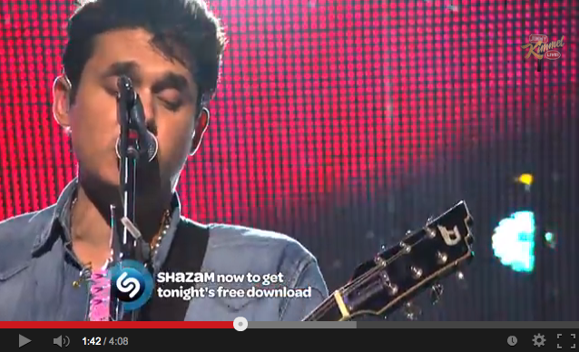
Jimmy Kimmell Live:
1st “Shazamable” show
Source: Youtube
Notes:
Shazam said ABC’s Jimmy Kimmel Live has become the 1st late night “Shazamable” show, meaning it supports the company’s 2nd screen app, which uses automatic content recognition (ACR) tech to trigger interactive apps that sync up with the live program.
The 1st Shazam-based interaction on the show occurred during the Monday night (Sept 30) airing during the performance of The Lumineers. The app enabled users to unlock a free track download from The Lumineers’ recently released deluxe edition album and to access a list of other songs performance during the show with links to purchase or share them.
Shazam also plans to offer a free download from John Mayer during his performance on Jimmy Kimmel Live’s airing on Thursday night (Oct 3). Shazam is also connecting users to the Jimmy Kimmel YouTube channel and the show’s music channel at any other time during each evening’s show. Shazam claims to support more than 160 channels, 100 million U.S. users, and 375 million registered users worldwide. In July, America Movil, the carrier led by billionaire Carlos Slim, invested $40 million into Shazam, which is using the funds to accelerate its music business, its drive into TV, and on product R&D.
Shazam has not said when it might pull the trigger on a public offering. Shazam said its engagement rates are driving about $300 million in digital music sales annually - See more at: http://www.c2meworld.com/creation/shazam-gets-interactive-with-jimmy-kimmel-live/#sthash.EaLrVIG5.dpuf
October 01, 2013

Slide 47
Notes:
je scan un show (mad men) pour savoir quelle est la musique que j'entends... voir en pj tout le DETAIL qui m'est sorti... a propos de l'emission. je ne me savais pas que shazam etait integre!

Slide 48
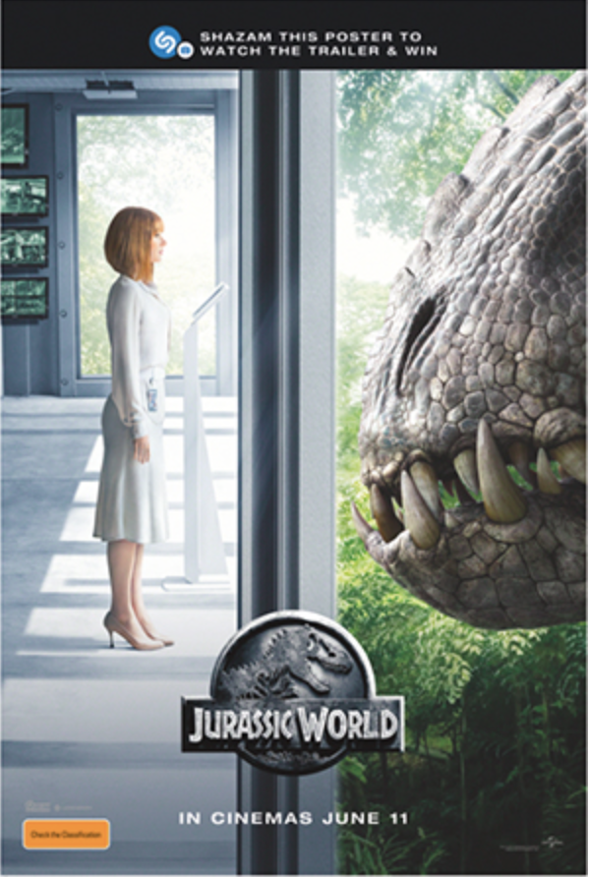
Notes:
http://www.digitalbookworld.com/2015/harpercollins-partners-with-shazam-on-interactive-mobile-marketing/?et_mid=755192&rid=246397558
Shazam can now scan objects in its quest to make the whole world Shazamable

Slide 49
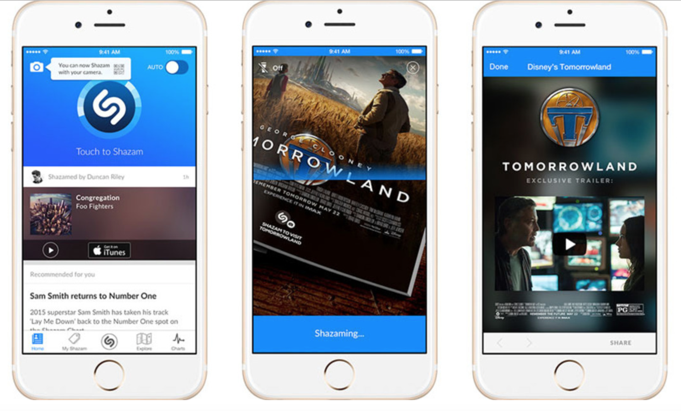
Notes:
http://www.digitalbookworld.com/2015/harpercollins-partners-with-shazam-on-interactive-mobile-marketing/?et_mid=755192&rid=246397558
Shazam can now scan objects in its quest to make the whole world Shazamable
Shazam can now scan objects in its quest to make the whole world Shazamable
http://mashable.com/2015/05/28/shazam-visual-capability/
Shazam — not quite content with being the app you use to dredge up the name of the darn song you can't remember — is deciding to get into the visual content game.
The company announced on Thursday it is moving beyond music identification and introducing a new visual recognition capability for users worldwide. If you have the latest version of Shazam installed on you smartphone, you should see a camera icon added to the app.
SEE ALSO: GoPro unveils drone, six camera array for VR content
To launch Shazam's interactive content on mobile, simply hold your camera steady and tap the icon when you see Shazam visual's watermark — its logo with a tiny camera — displayed on anything from magazine ads to beer coasters.
While plenty of technology companies from Amazon to Baidu are hard at work developing visual search capabilities, Shazam isn't chasing that exact dream.
Rather, Shazam's new visual recognition capability is about helping brands serve up extra, customized content to consumers, in a manner similar to QR codes. Steve Sos, Shazam's vice president for the Asia Pacific region, told Mashable Australia
"visual Shazaming" is a natural progression for the company.
"visual Shazaming" is a natural progression for the company.
"Our heritage is around music discovery, but in recent times we've moved into the media and content discovery space," he said. "It means that our gateway into content is no longer just acoustic."
Some of Shazam's initial brand partners in different markets include The Walt Disney Company, Target, Conde Nast and HarperCollins Publishers.
In Australia, Universal Pictures International will add content to the app in advance of its new film, Jurassic World. If Australian users Shazam a Jurassic World poster, for example, they will be able to book movie tickets, watch the trailer and explore the film's famous park from their phone.
IMAGE: SHAZAM
"We wanted new ways for people in Australia to engage with our upcoming blockbuster movies Jurassic World and Minions," Suzanne Stretton-Brown, marketing director at Universal Pictures International, Australia, said in a statement. "The launch of the visual functionality on Shazam is allowing us to make our movie artwork more interactive and exciting."
With more than half a billion global users and more than 100 million monthly active users, Shazam is excited about the ability to deliver a unique and turn-key solution for marketers, Sos said. Shazam users, on the other hand, will be able to explore content from a range of entertainment brands, when and where they want it.
Shazam introduces visual recognition capabilities
SHARE THIS STORY
SIMPLE SHARE BUTTONS ADDER (5.6) SIMPLESHAREBUTTONS.COM
PRINT
SEND TO A FRIEND
Holly Ashford
Editor
29 May 2015
Shazam has unveiled a visual recognition functionality that extends the company’s mobile engagement platform. Thanks to a series of partnerships with companies worldwide, everything from posters, to packaged goods, to print media, can be transformed from static images into ‘dynamic pieces of content’, the company claims. Visual recognition is developed in partnership with Digimarc.
Starting today, users with the latest version of Shazam installed on their mobile phones can open the app by tapping the new camera icon. Waving their phone over any item with the Shazam camera logo on it or a QR Code, will allow users to access custom mobile experiences including interactive content, special offers, and ability to purchase items or share them with others. This capability will live side-by-side with the existing Shazam audio functionality.
Shazam boasts 100 million monthly active users, and the new feature is designed to provide a way for brands to drive more impactful engagements with a large audience, and build unique mobile experiences for these brands. Companies participating in the initial launch include, in the US: The Walt Disney Company, HarperCollins Publishers, Esquire, Time Inc, and The Wall Street Journal.
Disney partnered with Shazam to create the world’s first visually Shazamable ad (for the Tomorrowland film) and will continue to roll out visual Shazam-enabled content for upcoming movies. Disney Music Group will also be part of the visual Shazam rollout with content from their artists being Shazam-enabled.
Across the rest of the world, Shazam has announced partnerships with brands including boohoo.com, House of Guerlain, Evian and Warner Bros. Interactive Entertainment, which is using Shazam to promote its upcoming Batman: Arkham Knight video game for its June 24 Australian launch.
“The introduction of visual recognition is another step on our journey to extend the ways people can use Shazam to engage with the world around them,” said Rich Riley, CEO, Shazam. “For brands, we’re providing a near-frictionless way to engage customers on their mobile devices, with a single tap of a button.”

Slide 50
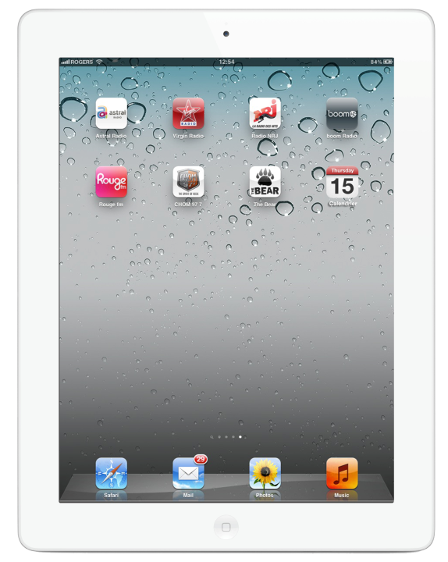
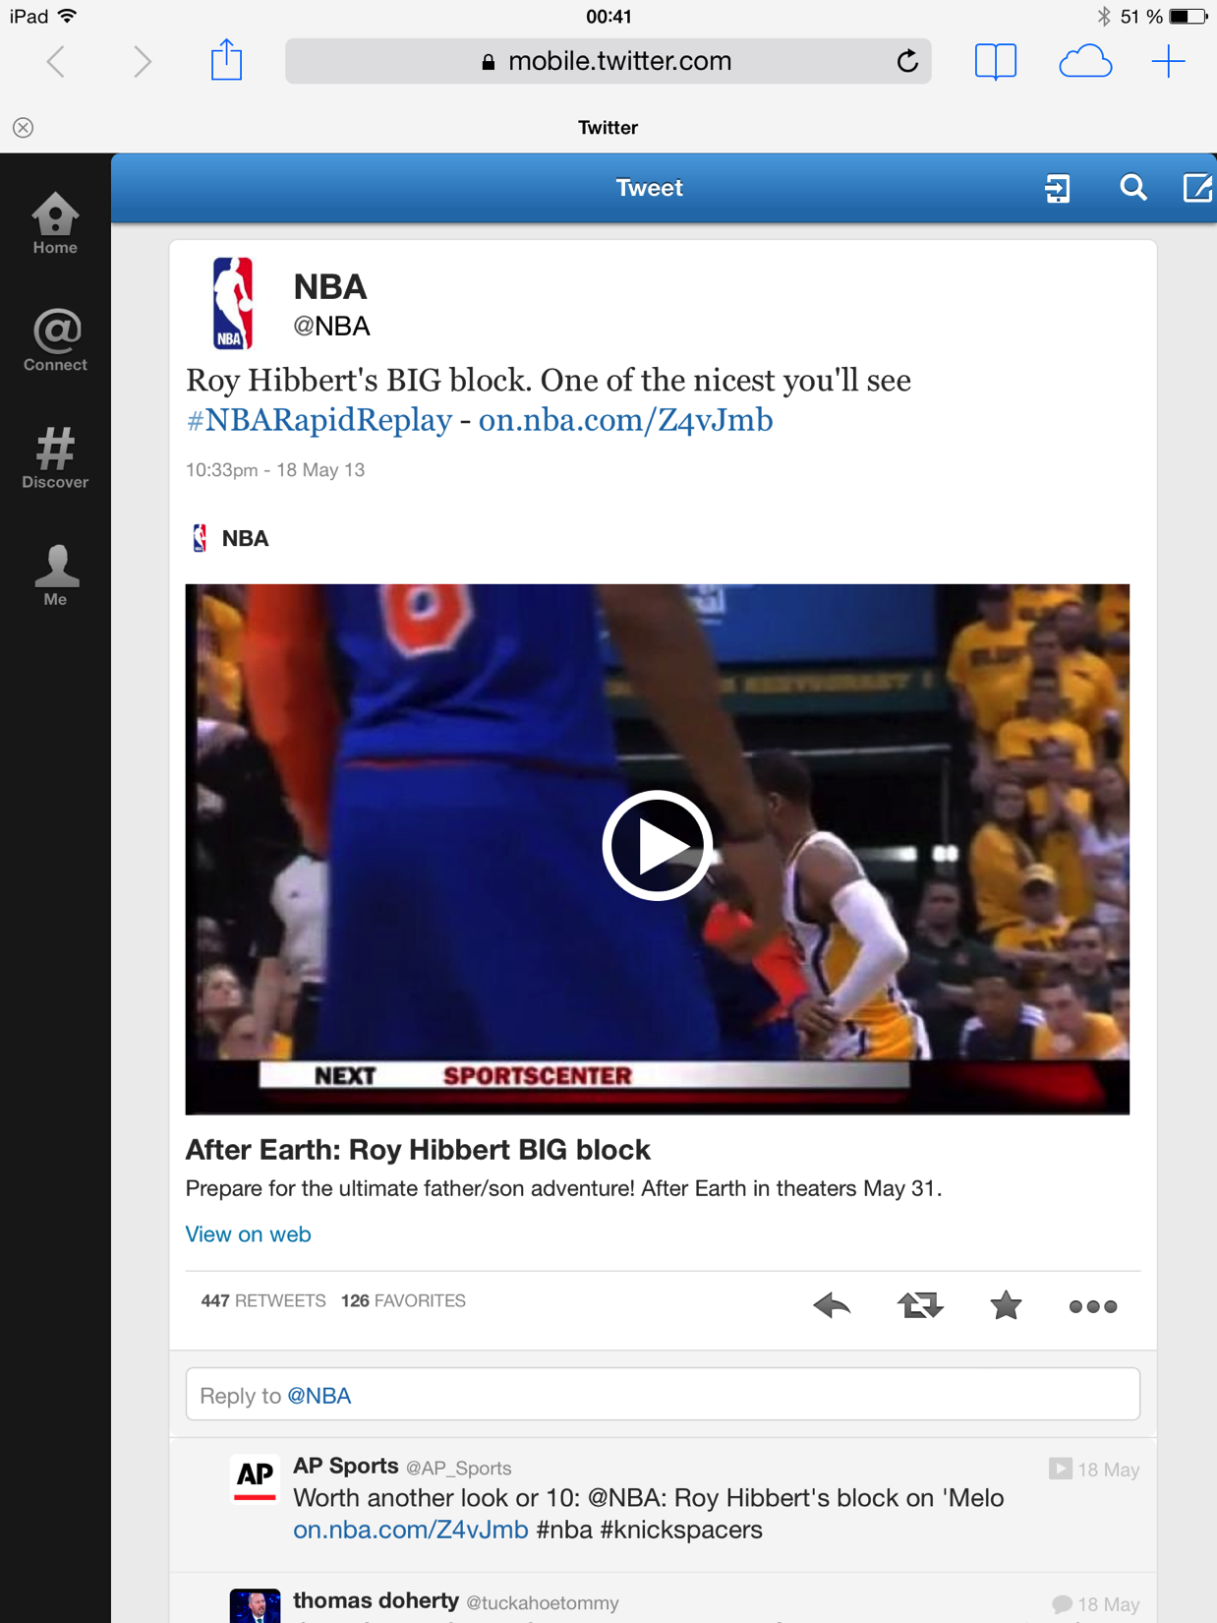
Source: twitter.com/NBA
Notes:
YouTube et réseau communautaire Facebook et maintenant Twitter devenus de puissants relais pour la diffusion de vidéos

Slide 51
Notes:
http://www.sportsnet.ca/hockey/nhl/elderly-pittsburgh-fan-steals-puck-from-little-kid-in-crowd/
JEFF SIMMONS OCTOBER 29, 2015, 9:00 PM
Some hockey fans take themselves a bit too seriously. And that can lead to some boneheaded decisions.
Such was the case in Pittsburgh Thursday evening. And one particular fan broke a rule of basic common sense — don’t steal things from children.
During a stoppage in play of the Penguins-Sabres game, Buffalo head coach (and former Pittsburgh bench boss) Dan Bylsma was tossing a puck to a little kid in the crowd before it was intercepted by an elderly fan.
He looked proud of himself too. Lame.
However, a GIF of the act blew up on social media and the Penguins caught word of what had happened, immediately tweeting out a response and providing a nice gesture for the young fan.
At least someone has some class.

Slide 52
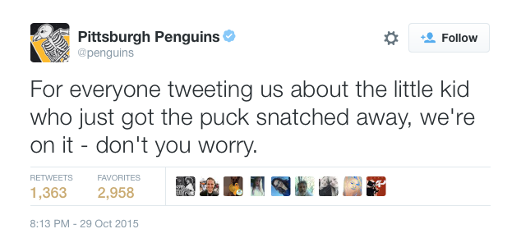
Notes:
http://www.sportsnet.ca/hockey/nhl/elderly-pittsburgh-fan-steals-puck-from-little-kid-in-crowd/
JEFF SIMMONS OCTOBER 29, 2015, 9:00 PM
Some hockey fans take themselves a bit too seriously. And that can lead to some boneheaded decisions.
Such was the case in Pittsburgh Thursday evening. And one particular fan broke a rule of basic common sense — don’t steal things from children.
During a stoppage in play of the Penguins-Sabres game, Buffalo head coach (and former Pittsburgh bench boss) Dan Bylsma was tossing a puck to a little kid in the crowd before it was intercepted by an elderly fan.
He looked proud of himself too. Lame.
However, a GIF of the act blew up on social media and the Penguins caught word of what had happened, immediately tweeting out a response and providing a nice gesture for the young fan.
At least someone has some class.

Slide 53
Notes:
http://www.sportsnet.ca/hockey/nhl/elderly-pittsburgh-fan-steals-puck-from-little-kid-in-crowd/
JEFF SIMMONS OCTOBER 29, 2015, 9:00 PM
Some hockey fans take themselves a bit too seriously. And that can lead to some boneheaded decisions.
Such was the case in Pittsburgh Thursday evening. And one particular fan broke a rule of basic common sense — don’t steal things from children.
During a stoppage in play of the Penguins-Sabres game, Buffalo head coach (and former Pittsburgh bench boss) Dan Bylsma was tossing a puck to a little kid in the crowd before it was intercepted by an elderly fan.
He looked proud of himself too. Lame.
However, a GIF of the act blew up on social media and the Penguins caught word of what had happened, immediately tweeting out a response and providing a nice gesture for the young fan.
At least someone has some class.

Slide 54
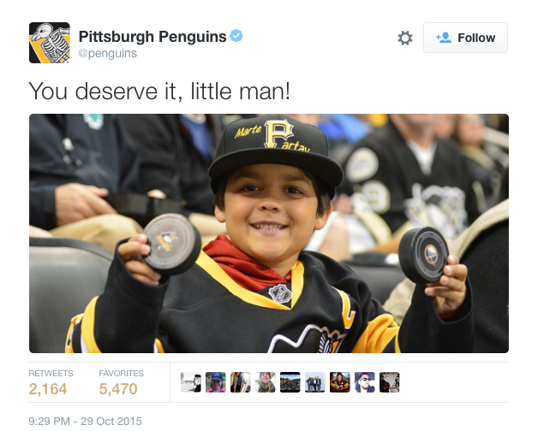
Notes:
http://www.sportsnet.ca/hockey/nhl/elderly-pittsburgh-fan-steals-puck-from-little-kid-in-crowd/
JEFF SIMMONS OCTOBER 29, 2015, 9:00 PM
Some hockey fans take themselves a bit too seriously. And that can lead to some boneheaded decisions.
Such was the case in Pittsburgh Thursday evening. And one particular fan broke a rule of basic common sense — don’t steal things from children.
During a stoppage in play of the Penguins-Sabres game, Buffalo head coach (and former Pittsburgh bench boss) Dan Bylsma was tossing a puck to a little kid in the crowd before it was intercepted by an elderly fan.
He looked proud of himself too. Lame.
However, a GIF of the act blew up on social media and the Penguins caught word of what had happened, immediately tweeting out a response and providing a nice gesture for the young fan.
At least someone has some class.

Slide 55
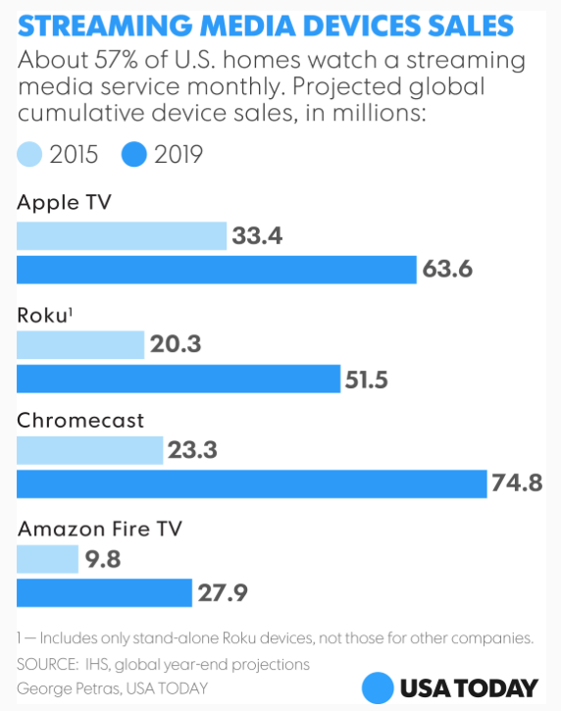
Notes:
http://www.usatoday.com/story/tech/2015/11/01/cutting-cord-battle-net-tv-devices/74750574/
Cutting the Cord: Battle of the Net TV devices
Mike Snider, USA TODAY 2:54 p.m. EST November 1, 2015
The battle of the streaming media devices is heating up with a refreshed Apple TV device joining the fray.
Apple's latest set-top box ($149 for 32 gigabytes of storage or $199 for 64GB) has more streaming apps, lets you search for movies using Siri and sports a new touch remote.
It's just the latest upgraded entry in the fight to be the Internet streaming video device in your living room.
A few weeks back, Roku unveiled a new Roku 4 streaming set-top box ($129.99) that is just now hitting stores. Among its upgrades: 4K Ultra HD streaming from sites such as Amazon Video, M-Go and Netflix.
Back in September, Google launched an improved Chromecast Net device ($35) that connects to your TV and lets you watch apps such as Netflix and Sling TV. Also announced in September, the new Amazon Fire TV streaming set-top box ($99-up) is arriving this week with enhancements that include voice support and the ability to watch 4K Ultra HD video.
The Amazon Fire TV set-top box with voice remote and
The Amazon Fire TV set-top box with voice remote and game controller, also sold separately. (Photo: Amazon)
A sign of the heated streaming scuffle: Amazon recently pulled competing Apple TV and ChromeCast devices from its online store to avoid confusion for Prime Video customers, the company said at the time. "That shows you the intensity of the battle," says Roger Entner, an industry analyst at Recon Analytics.
Half of U.S. homes already subscribe to a streaming service such as Netflix, Amazon Prime Video or Hulu, and the percentage of those with traditional pay TV is declining. Next year, Entner expects the number of streaming households to eclipse the number of pay-TV households. "Viewing habits have changed," he said. "People are relying on streaming over-the-top apps and supplementing their sports addiction with over-the-air television."
As more consumers experiment with and rely on streaming video, networks and content providers expand their offerings. As a result, "there has been this explosion of streaming boxes that allow content companies to talk to consumers in their homes," says Jason Krikorian, co–founder of Sling Media and general partner at DCM Ventures, a tech-focused venture capital firm.
"Young people look at 1,000 channels that are pushed to them via the cable bundle and say, ‘Why do I need that when all I care about is eight shows and a couple of sports teams?'" he said. "They are interested in new kinds of solutions.”
The new Apple TV Net TV set-top box and remote.
The new Apple TV Net TV set-top box and remote. (Photo: Apple)
Apple and Amazon have advantages going forward, Krikorian says. Beyond the Apple ecosystem, which includes iPhones, iPads and iTunes, the new Apple TV's user interface allows the app catalog to grow to the thousands "we are used to on our mobile devices," he said.
USA TODAY
New apps for Apple TV - a guide
Similarly, Amazon encourages subscribers to its Prime service — free two-day deliveries are a benefit for the $99 annual fee — to get a Fire TV device because they can watch free movies and TV episodes, including a growing slate of Amazon's original programs.
The Google Chromecast device plugs into your TV, connects
The Google Chromecast device plugs into your TV, connects to the Net and lets you cast content from your computer or device. (Photo: Google)
As for Chromecast, its economical pricing makes it an easy purchase. And once consumers get the hang of casting content to the TV, "it's a proposition that has teeth," says Paul Erickson, senior analyst with IHS Technology. "It's an inexpensive option and a way for you to get from your mobile phone to the big-screen. ... It's selling through in huge numbers."
He also expects Roku to continue to be a major player because, "it's arguably the most consumer-friendly in the segment, both in terms of options and different prices and pure amount of content access you get."
The Roku 4 Net TV set-top box and remote
The Roku 4 Net TV set-top box and remote (Photo: Roku)
Roku for now remains the market leader, says Brett Sappington, director of research at tech research firm Parks Associates. "Over one-third of households with a streaming media player have a Roku device, and adoption figures are still climbing," he said.
Over the last year and a half, Apple TV's share of the streaming media marketplace has been "no better than stable," he said. The new Apple TV will likely get "a bounce" but it must appeal beyond current owners -- who may buy the new version -- to grow its market share, he said. "Apple TV's premium price may cause many consumers to go with Roku or another less expensive option."
Hardware is all and good, but the flood of content is driving all of this. "We are seeing a growth of more streaming services here and abroad," Erickson said. "Netflix is creating visibility for (streaming video) worldwide, but we have a lot more nationally and locally streaming services popping up over the world. … We're only going to see that increase."
"Cutting the Cord" is a regular column covering Net TV and ways to get it. If you have suggestions or questions, contact Mike Snider via e-mail at msnider@usatoday.com. And follow him on Twitter: @MikeSnider.

Slide 56
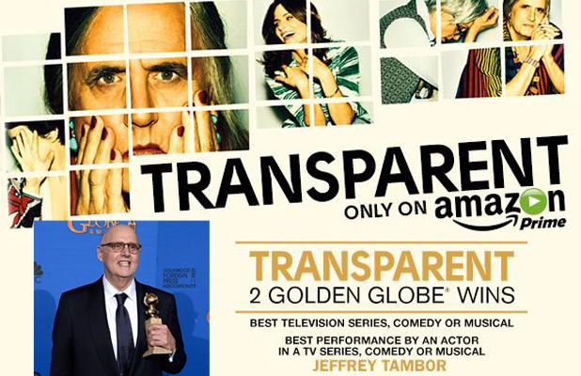
Notes:
http://plus.lapresse.ca/screens/3d28e8a1-cc62-4819-8aeb-8e6da5ae6a14%257C_0
À la remise des prix Golden Globes, en janvier, la série Transparent a remporté le prix de la meilleure série télé. Transparent ne porte pas la signature d’un grand réseau comme ABC, CBS ni même HBO ou Netflix. Cette série, qui raconte l’histoire d’un père de famille transgenre, a été produite par Amazon Prime et diffusée en ligne. Amazon (oui, le site où on achète des livres) n’est pas la seule plateforme à s’être lancée dans la production originale.

Slide 57
Notes:
http://www.virgin.com/richard-branson/stand-out-or-stand-still

Slide 58
Notes:
https://www.youtube.com/watch?v=bjsHiWguvKA

Slide 59
Notes:
Pls send video file
https://www.youtube.com/watch?v=bjsHiWguvKA

Slide 60
Watch
What people
Who don’t watch TV
Watch

Slide 61
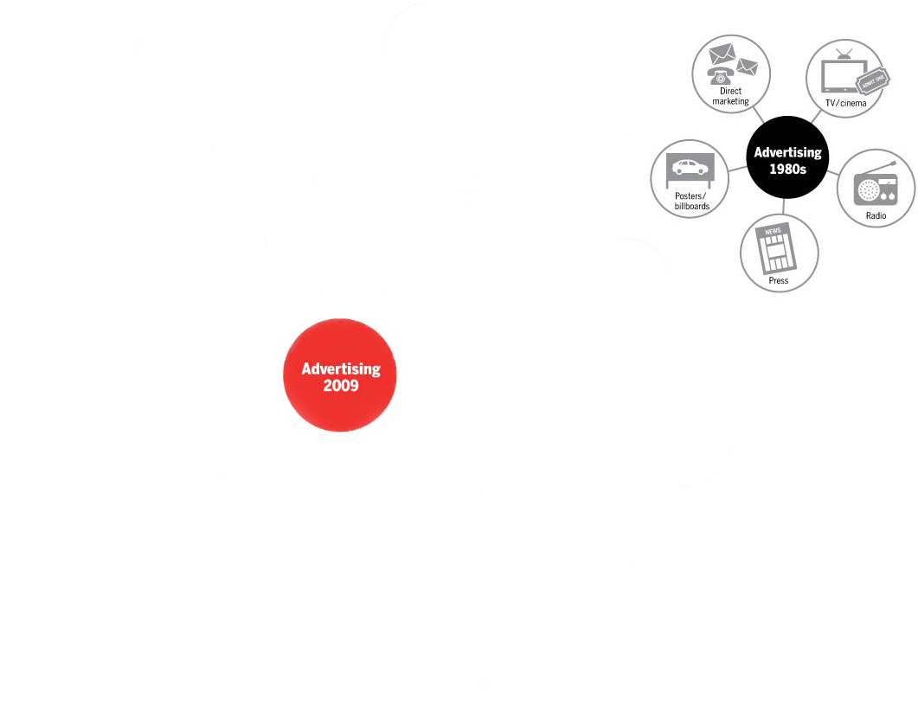
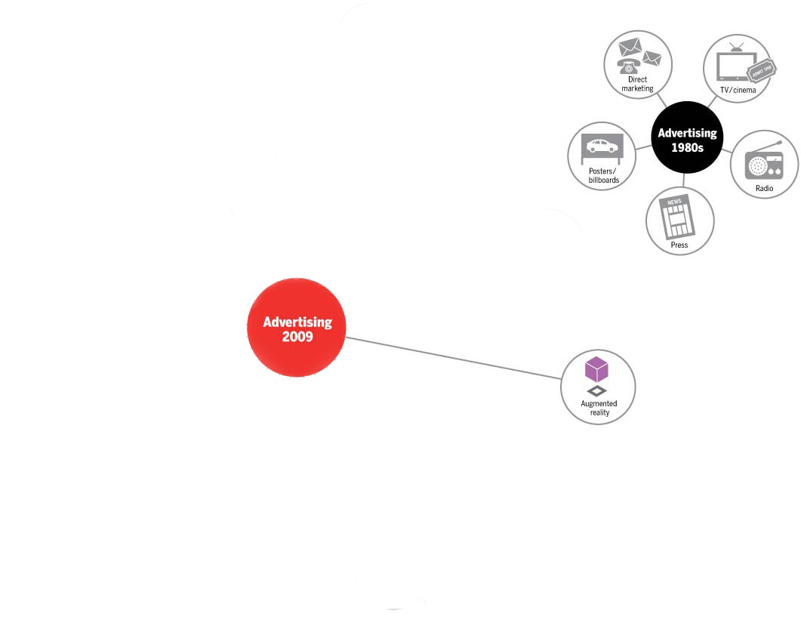
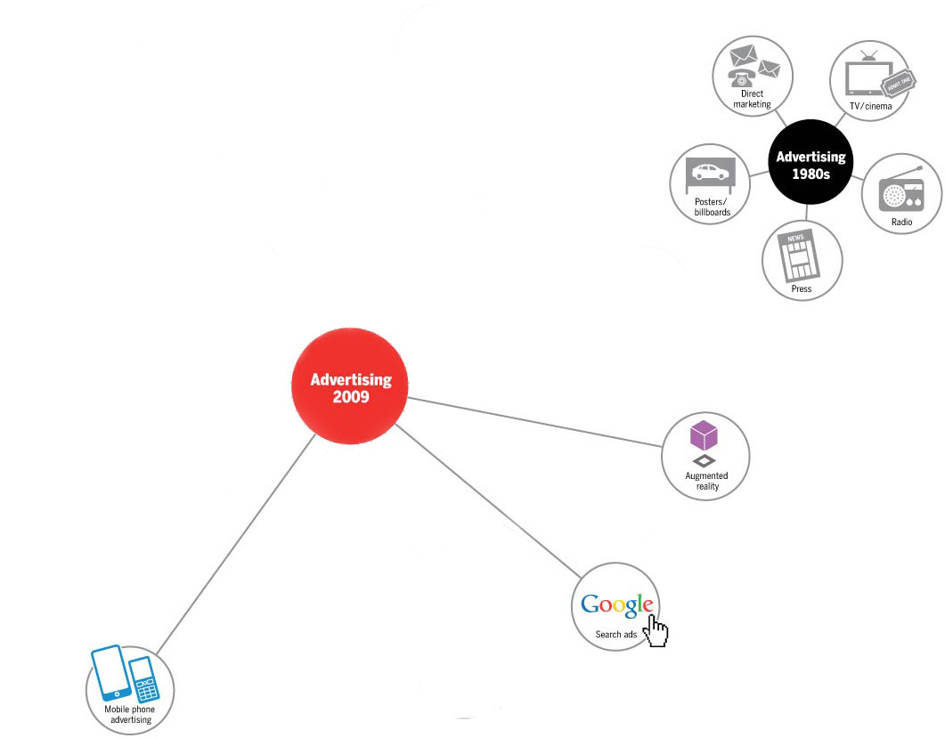
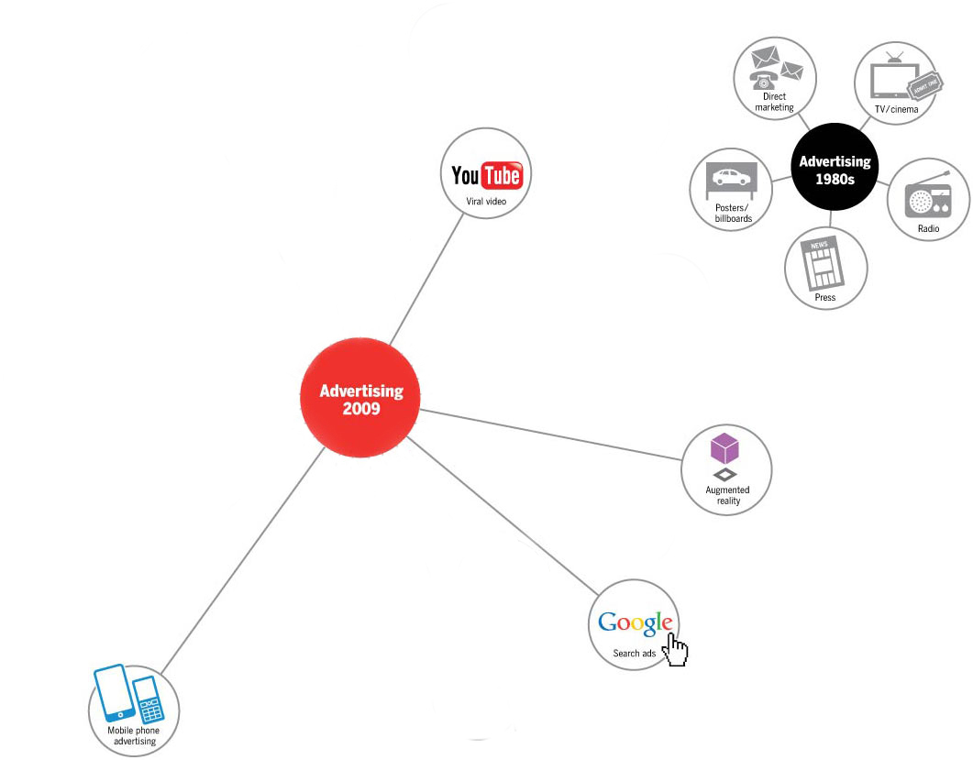
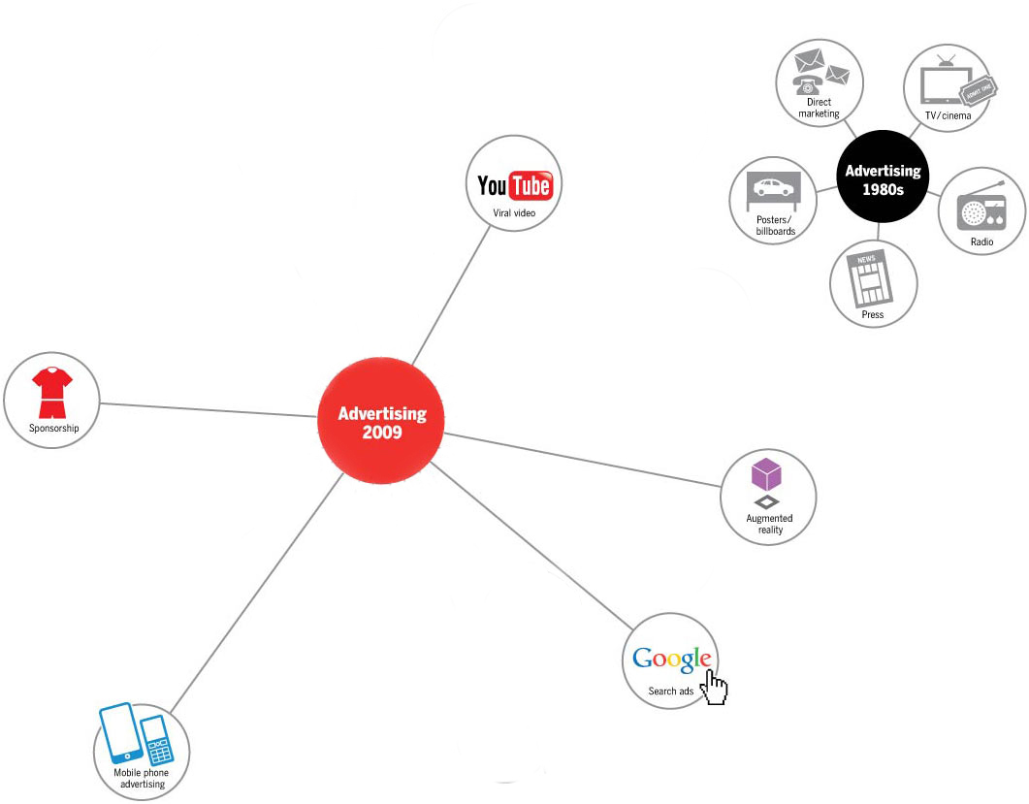
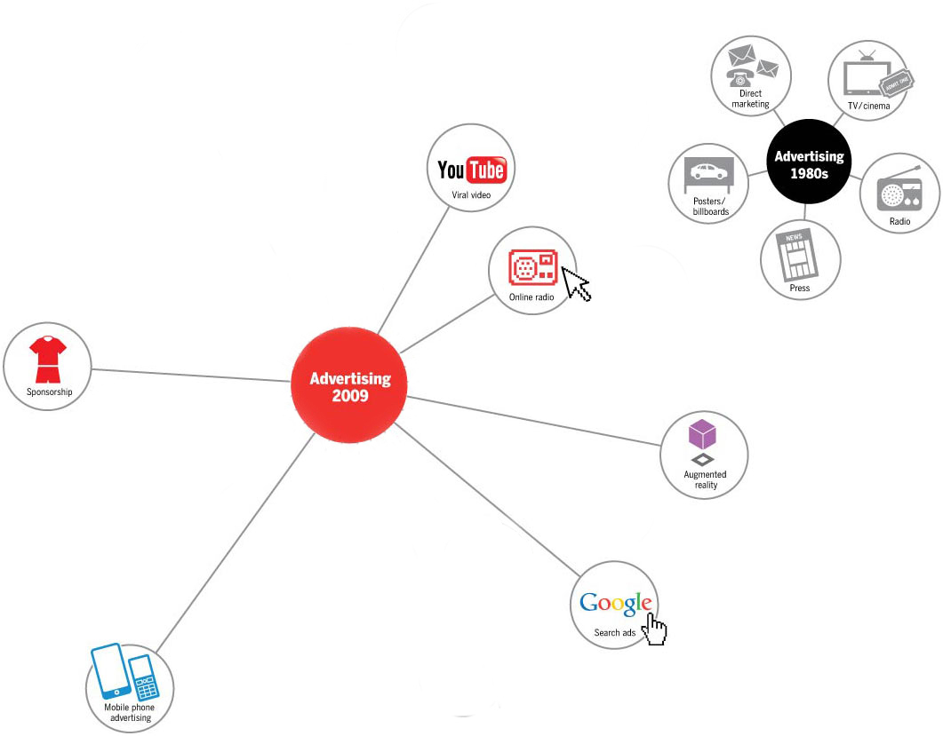
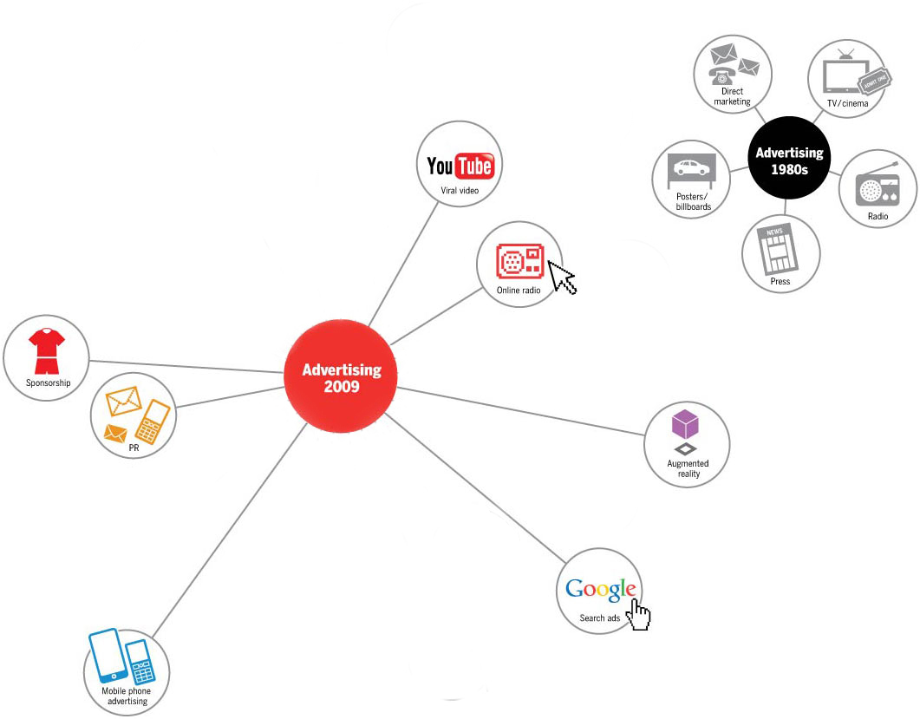
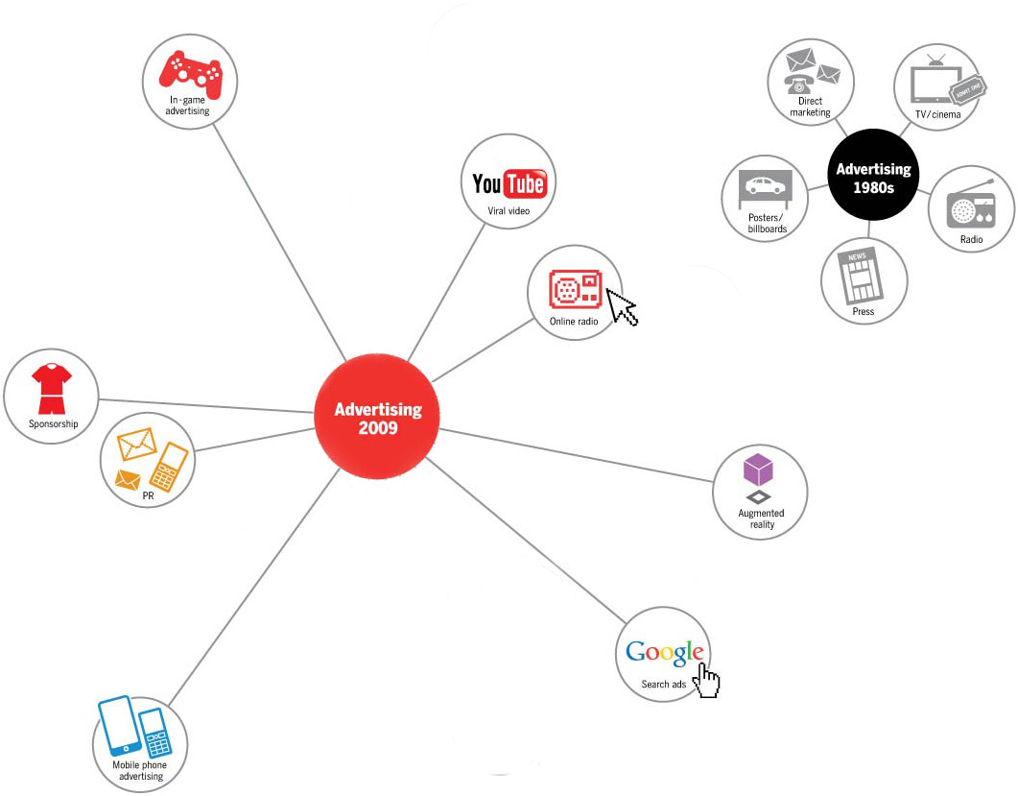
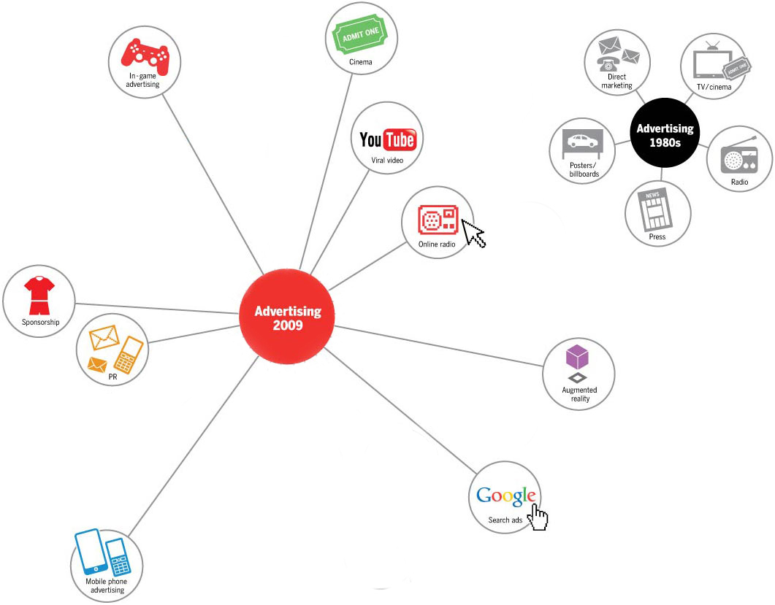
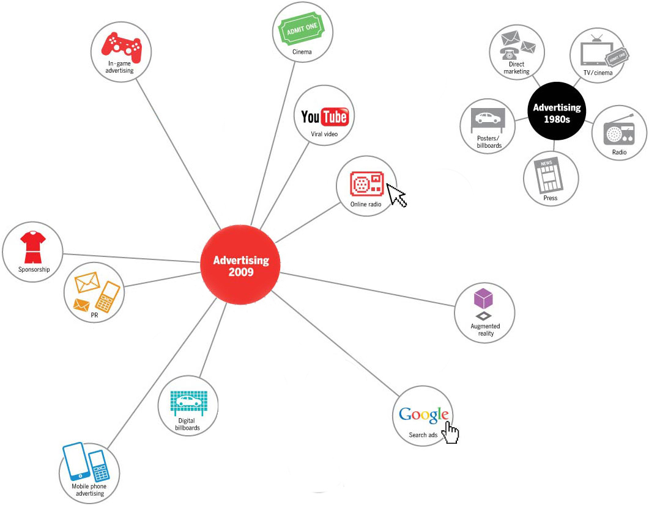
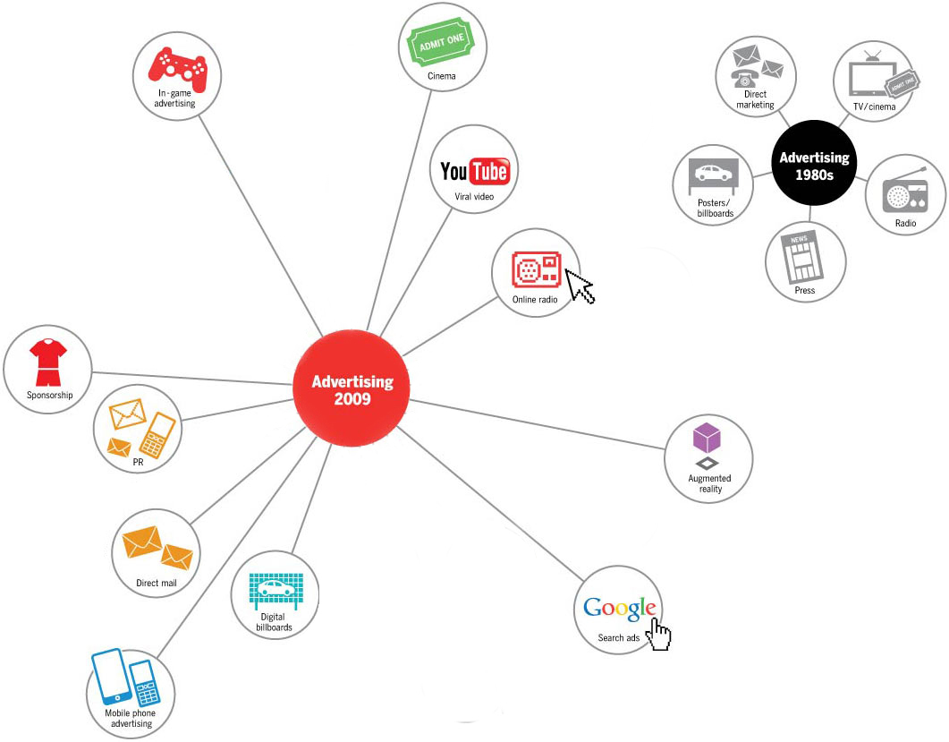
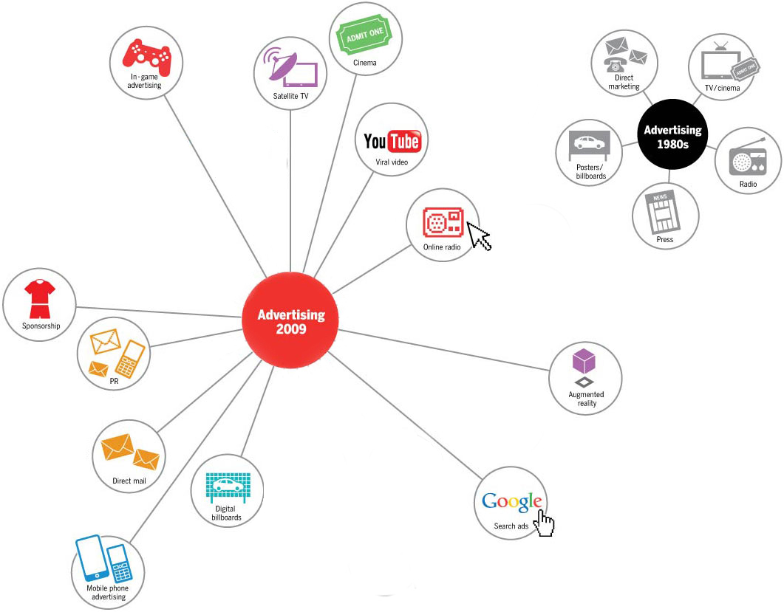
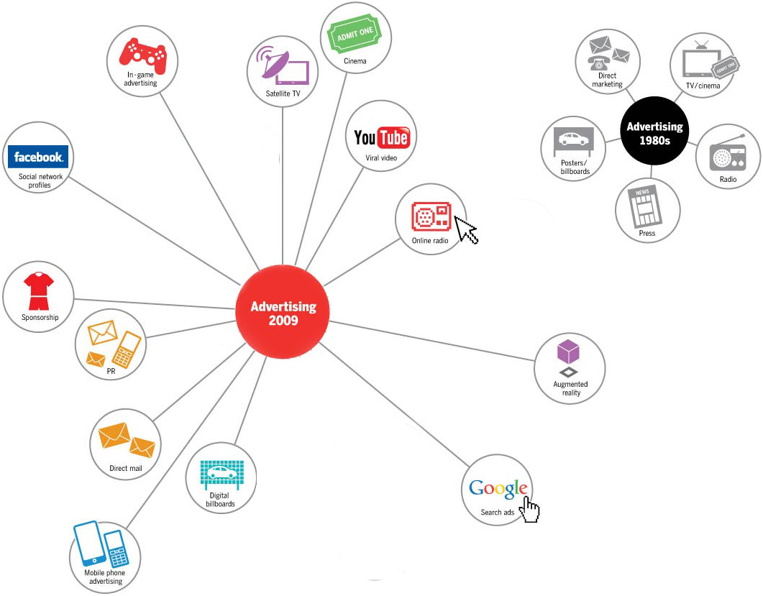
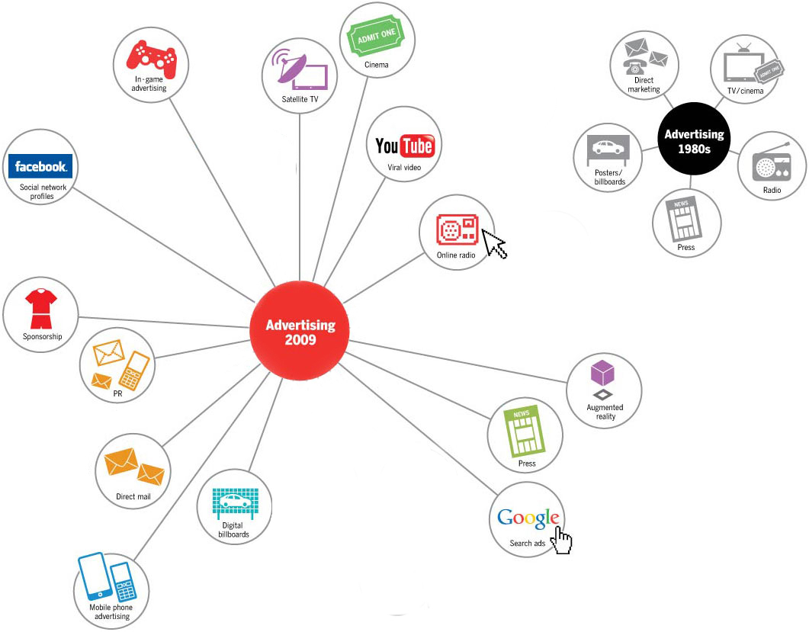
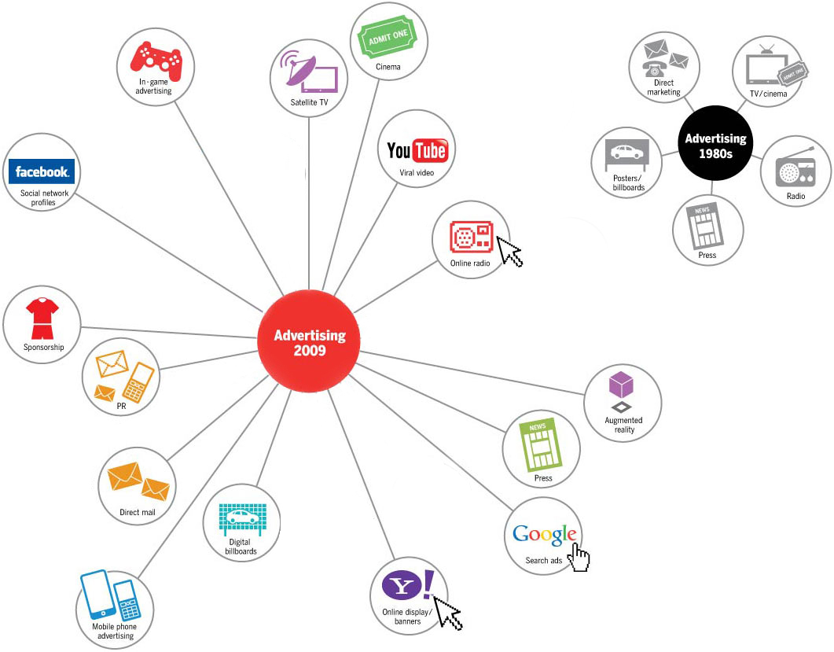
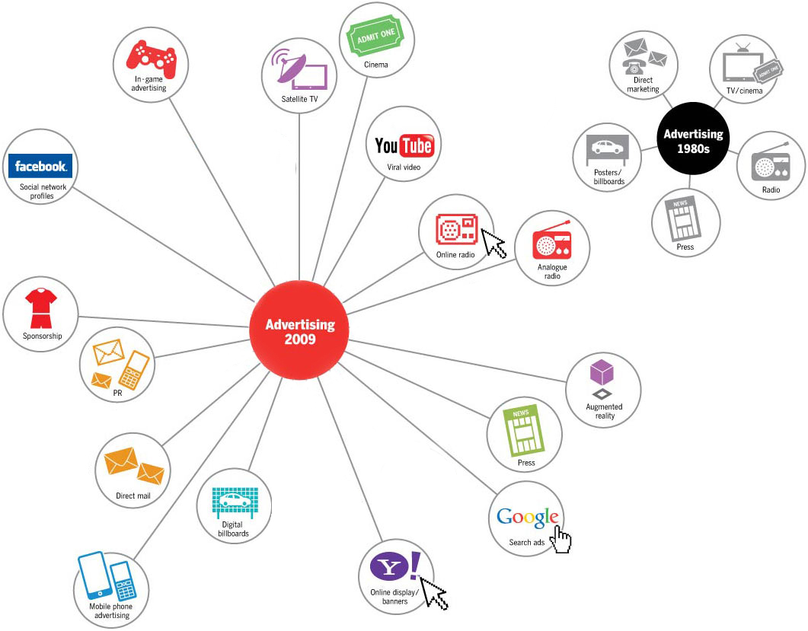
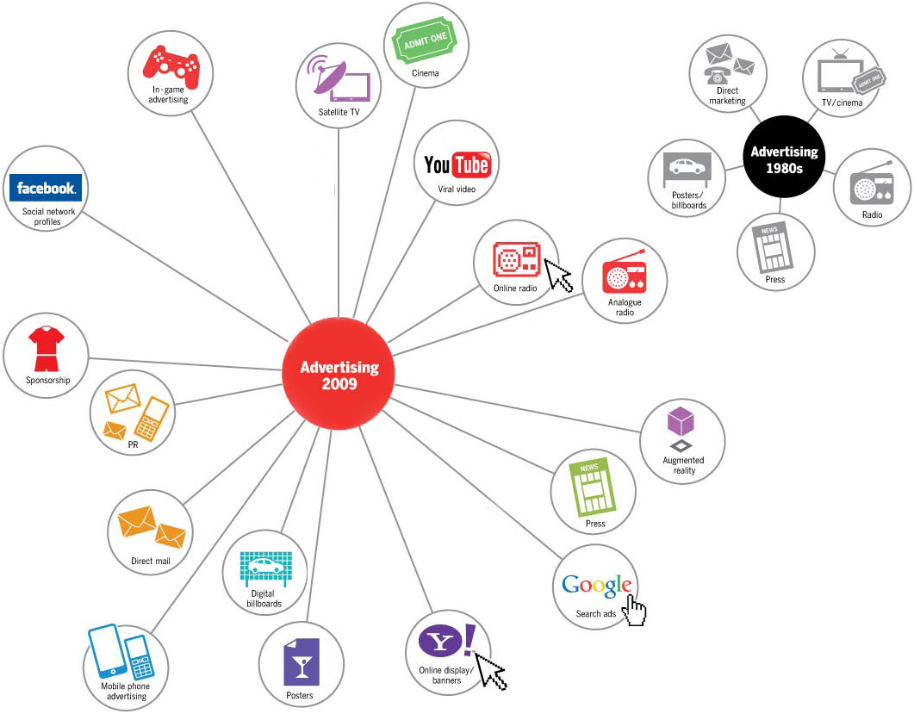
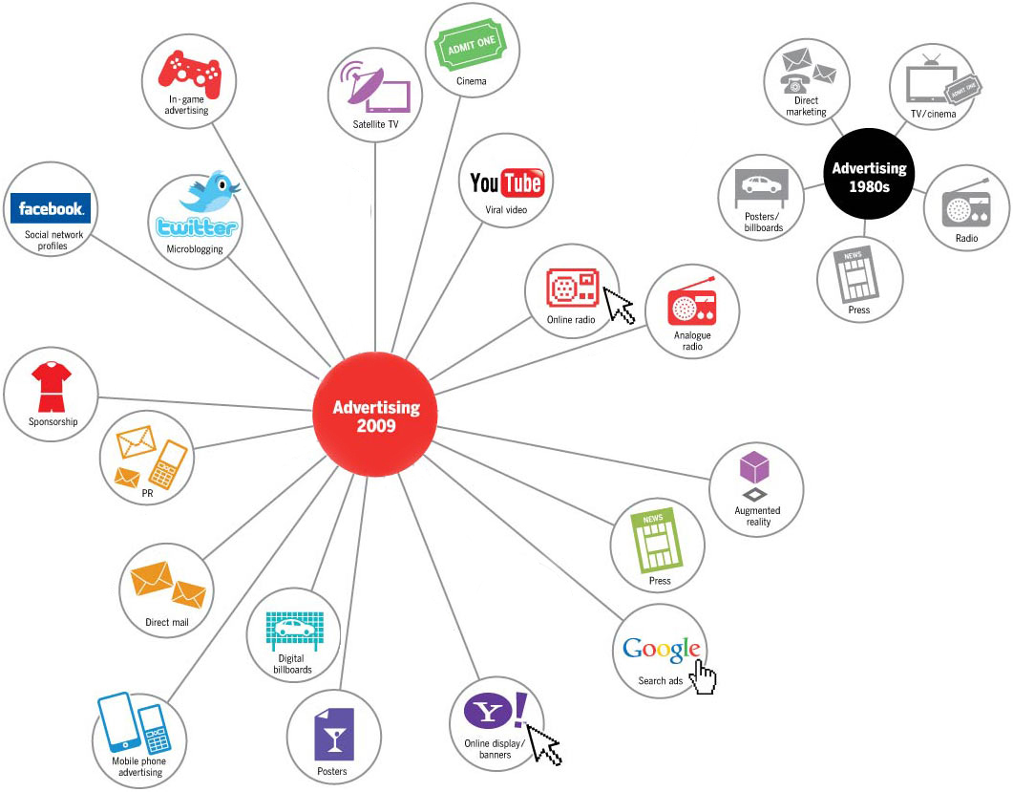
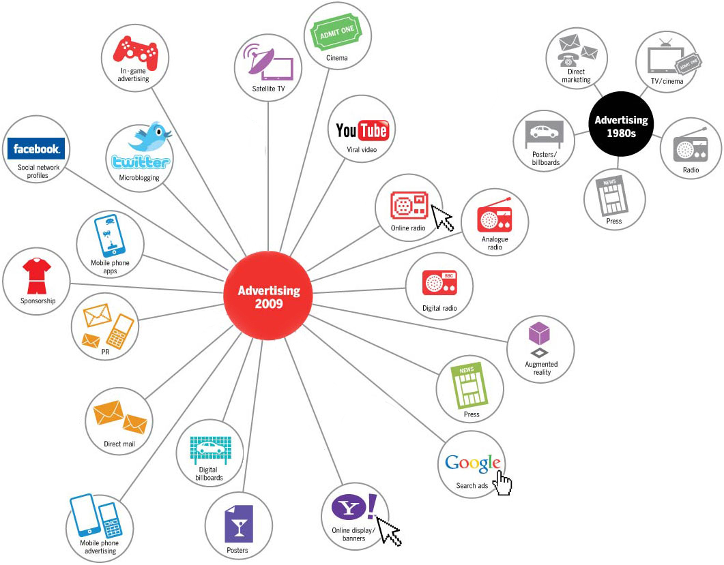
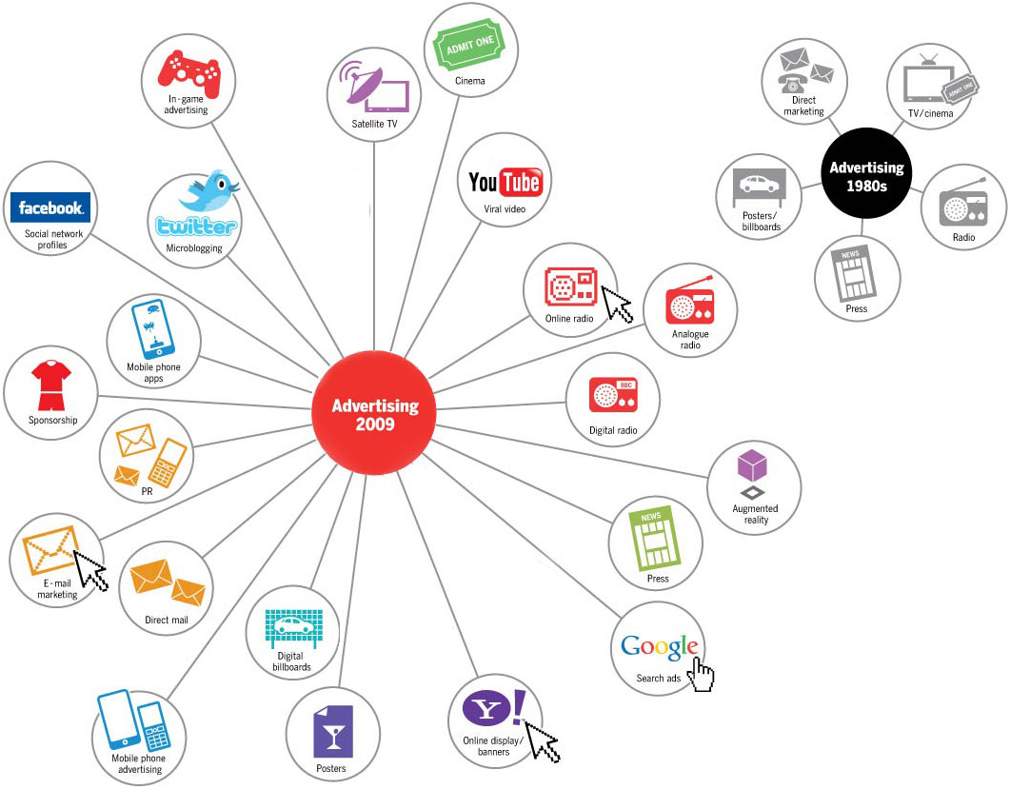
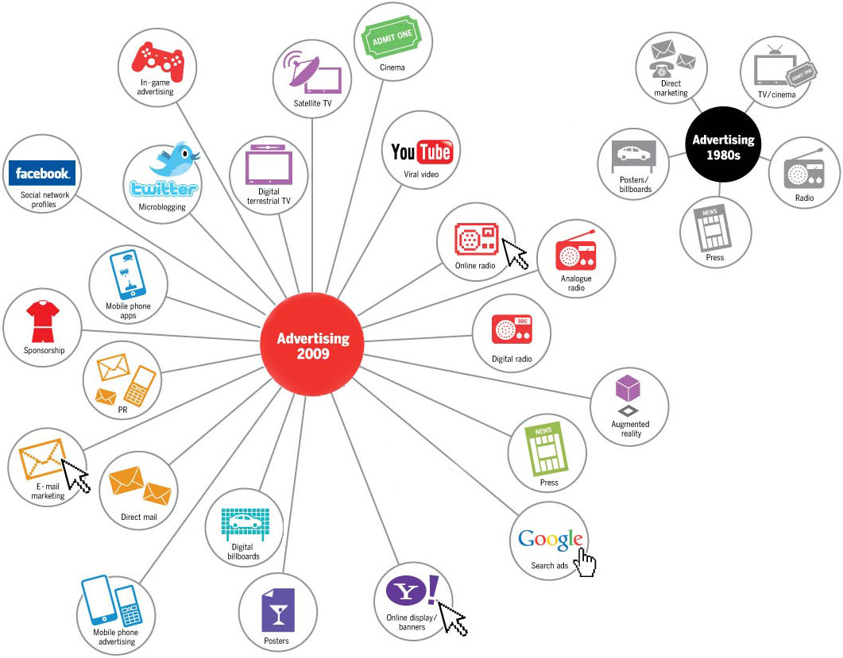
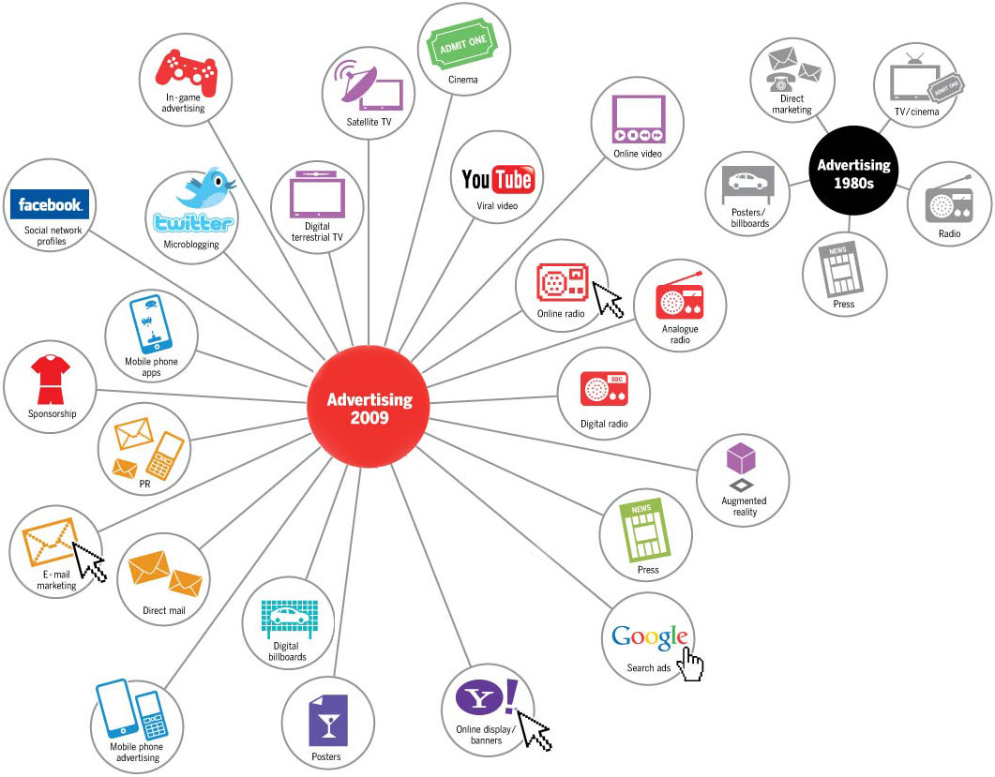
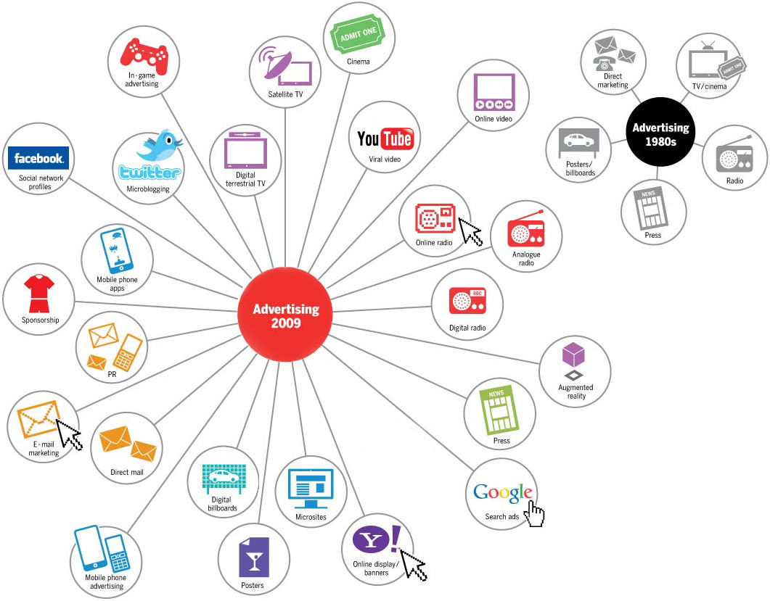
Publicité
1980
Publicité
2015

Slide 62
We have to, as a marketing industry,
media industry and agency industry,
continue to think about ways
that we can be disruptive…
expecting what you did last year
to work this year
is a high risk.
Bradley Jakeman,
President, global beverage group, PepsiCo,
at the ANA Masters of Marketing Conference.
Oct. 15th, 2015
Notes:
http://www.chiefmarketer.com/pepsico-talks-disruptive/?hq_e=el&hq_m=2478224&hq_l=2&hq_v=6e7c5d1ea8
PEPSICO TALKS ABOUT HOW TO BE DISRUPTIVE
Posted on October 15, 2015 by Patricia Odell
Disruption is a major issue for marketers: how can they and their brands be disruptive and, on the flip side, how can they prevent being disrupted themselves.
As an example, Uber burst onto the scene in 250 cities across 50 countries. That took less time than it takes the average person to graduate college. Uber disrupts well-established businesses, including New York City’s Yellow Cabs that have been ferrying people around the city since 1907. Blockbuster, Nokia and Kodak are among others that have been disrupted right out of business.
Brad Jakeman, PepsiCo
“What has changed is the speed in which change is happening and new business models are scaling,” said Bradley Jakeman, president, global beverage group, PepsiCo, at the ANA Masters of Marketing Conference. “This notion of having a healthy paranoia [is not unfounded]. We have to, as a marketing industry, media industry and agency industry, continue to think about ways that we can be disruptive.”
Jakeman said he doesn’t pretend to have the answers, but that the first step is to internalize the problem and think about it: To think about how to prevent somebody­–more interesting to the consumer than the existing business model–from coming in and taking over, and how to invent and transition to that before somebody else does.
“I’m talking about a fundamental change in the business model,” he said. “A fundamental way of approaching marketing; a completely new way of doing business. I try and drive this notion in the organization that unless were constantly thinking about how we disrupt ourselves someone will come along and disrupt us.”
Concern over the impact of threats from more agile competitors saw the biggest year-over-year increase, jumping from 67% to 75%, according to a new survey, “Marketing Disruption II,” conducted by the ANA in conjunction with GfK, a global market research firm.
The focus on investment to counteract that competitive challenge over the next one to three years jumped from 51% last year to 66%. In addition, the survey found that many marketers are also breaking down some of the organizational barriers that traditionally hamper agility and flexibility, with a 65% increase in the shift to networked organizations.
Technology remains a significant disruptive force, with concern for the impact of the Internet of Things increasing almost 20%.
“It’s not that change is happening. The big news is the pace at which this is happening–that should make us more nervous and more paranoid,” PepsiCo’s Jakeman said. “Expecting what you did last year to work this year is a high risk.”

Slide 63
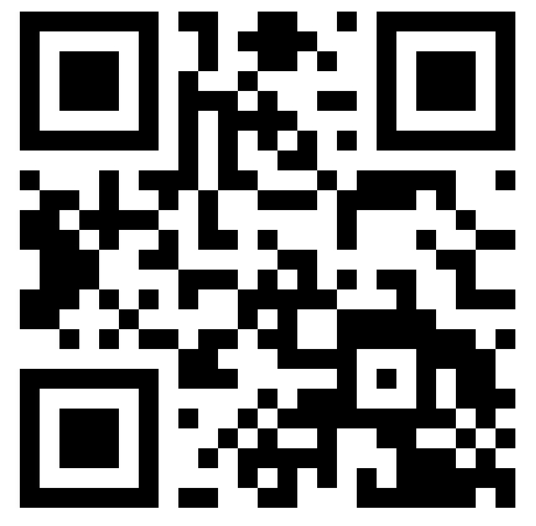
Pierre C. Bélanger, Ph.D
Department of Communication
Université d’Ottawa
@pbelang
pierre.belanger@uottawa.ca
Pierre C. Bélanger, Ph.D
Département de Communication
Université d’Ottawa
Pierre C. Bélanger, Ph.D
Département de Communication
Université d’Ottawa
Pierre C. Bélanger, Ph.D
Département de
Communication
Université d’Ottawa
Notes:
plus compliqué de parler de la télé ajd qu’il y a 10 ans. En plus des signaux de télédiffusion (que ce soit sur les ondes ou par l’intermédiaire d’un distributeur par satellite ou d’un câblo) et de la lecture de contenu télévisuel enregistré, on a aussi accès à des canaux en ligne tels que YouTube diffusant du contenu de courte et de longue durée, à des services de vidéo sur demande par contournement tels que Netflix Cda ou Hulu pour ceux qui peuvent obtenir une adresse IP aux États-Unis, et à des signaux de télévision piratés, diffusés en mode continu ou téléchargés par Internet. Et ces types de contenu peuvent être visualisés non seulement à la télé, mais aussi sur des ordis personnels, des tablettes et des téléphones intelligents. À noter que, dans cette prédiction, on entend par télé traditionnelle la télé en direct et la lecture de contenu enregistré sur un téléviseur, et l’on entend par télé non traditionnelle toute autre forme de télévision.
"The TV business is based on managed dissatisfaction. You're watching a great TV show you're really wrapped up in? You might get 50 minutes of watching a week and then 18k minutes of waiting until the next episode comes along.
Why do so many pirate BitTorrent sites thrive? "Because people are frustrated. In Scandinavia and the Netherlands, they have the fastest internet in the world and they're waiting 1 or 2 years to watch US shows. What do you think they're going to do?
Binging
«Ce n'est pas une crise économique que traversent TF1, Canal+ et M6, mais une mutation industrielle accélérée (...) menaçant à terme leur pérennité»,
Les Netflix de ce monde:
la puissance de ces groupes au «modèle économique mondial» qui s'appuient «sur des cadres législatifs et réglementaires plus souples» que ceux en vigueur en France, «tout en pratiquant «une optimisation fiscale exorbitante».

